Slide 1
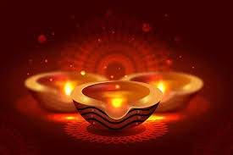
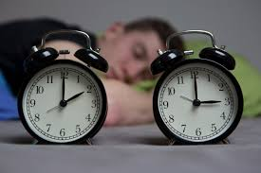
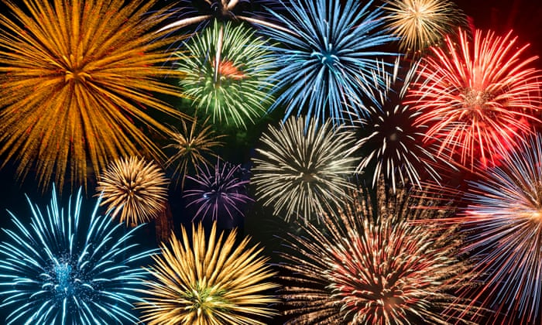
What’s the link?
Week beginning 1 November 2021

Slide 2
Light

Slide 3
Diwali – A festival of Light
Over 800 million people celebrate this in different ways
Honours and celebrates a range of Gods and Goddesses mainly in the Hindu Faith
Diwali means 'row of lighted lamps'
Symbolises the victory of light over darkness
A major shopping festival
Celebrated for 5 days with 4 November being the main event
Signals the onset of winter
The city of Leicester hosts the biggest celebrations outside of India

Slide 4
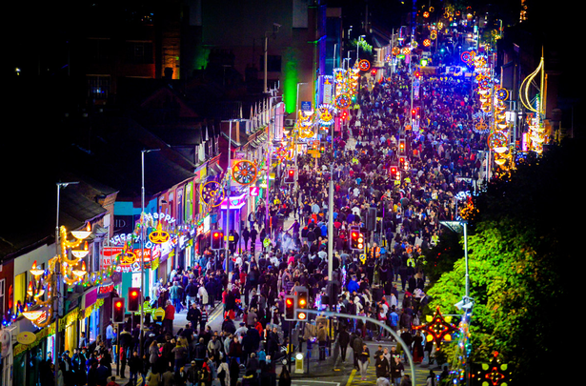
The Golden Mile: Leicester

Slide 5
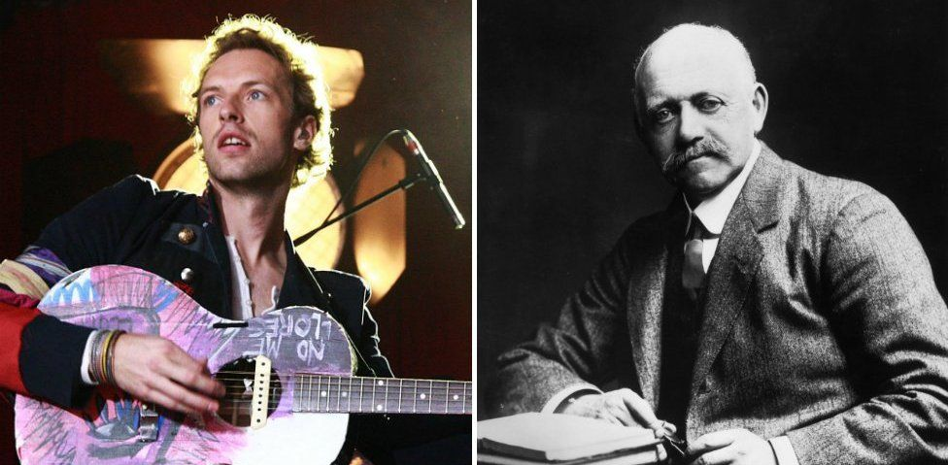
Daylight Saving:
Summer Time Act, 1916, came into effect following a campaign by builder William Willett to save energy and spend more time outdoors during the day
The ancient Romans also implemented a similar system as a means of using their time efficiently during the day.
In August 2018, the European Commission conducted a survey across the continent, which received responses from 4.6 million people. 80% of people wanted to stop daylight saving.

Slide 6
Filling the night sky with light:
"Remember, remember the fifth of November"…but not a lot else about bonfire night?
The Gunpowder Plot of 1605 was meant to kill the Protestant King, James I. and replace him with a Catholic Queen
It was actually Warwickshire-born Robert Catesby who led the Gunpowder Plot, not Guy Fawkes. There were also 13 other people involved
The job Guy Fawkes had in the Gunpowder Plot was to guard the 36 barrels of gunpowder that had been placed in a basement underneath the House Of Lords

Slide 7
The alarm was raised after an anonymous letter was sent to Lord Monteagle, warning him to stay away from the House of Lords
Explosive expert Fawkes, who had been left in a cellar to set off the fuse, was subsequently caught when a group of guards discovered him at the last moment on the 5th November. He was then taken to the Tower of London
As he awaited his grisly punishment on the gallows, Fawkes leapt to his death to avoid the horrors of torture that awaited him. He died from a broken neck.
King James I announced that the 5th November should be the day that people always celebrate that the Gunpowder Plot didn’t happen

Slide 8
The cellar that Fawkes and the gunpowder plotters used was damaged in 1834 by fire. When the Palace of Westminster was rebuilt in the 19th century, the infamous cellar was destroyed
St. Peters school in York is the only place in England that does not celebrate bonfire night as a show of respect for their former pupil, Guy Fawkes
The Houses of Parliament are still searched by the Yeoman of the Guards before the state opening (where the reigning Monarch visits parliament each year) held in November. It is ceremonial rather than serious and is performed with lanterns.

Slide 9
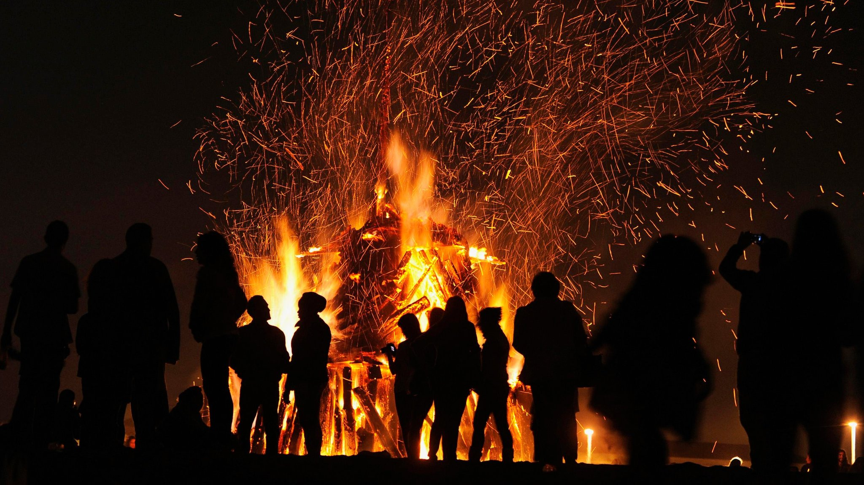

Slide 10
The advice about fireworks
Following the Firework Code
All fireworks should carry the CE mark
Remember that Fireworks are EXPLOSIVES
Respect your neighbours
Respect the emergency services
Stay safe!

Slide 11
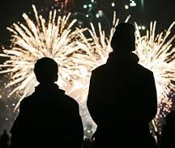
The Firework Code:
Plan your firework display to make it safe and enjoyable.
Keep fireworks in a closed box and use them one at a time.
Read and follow the instructions on each firework using a torch if necessary.
Light the firework at arm's length with a taper and stand well back.
Keep naked flames, including cigarettes, away from fireworks.

Slide 13
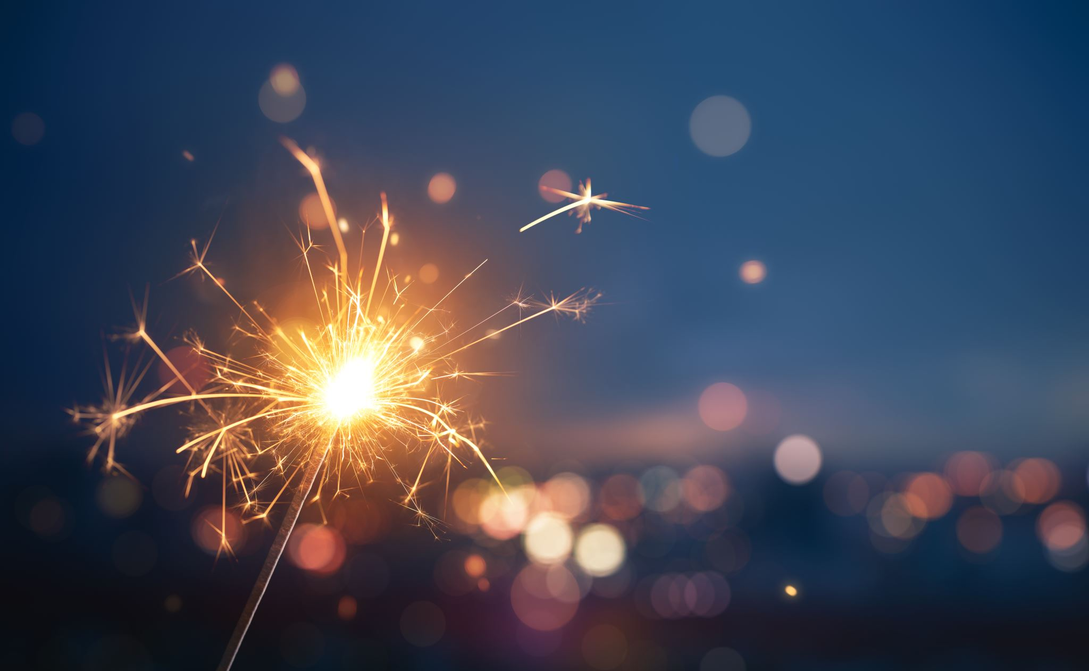
Go to a planned firework display:

Slide 14
“Light is the only connection we have with the Universe beyond our solar system and the only connection our ancestors had with anything beyond Earth. Follow the light, and we can journey from the confines of our planet to other worlds that orbit the Sun without ever dreaming of spacecraft."

Slide 15
Form Group | Pupil Name | Pupil Name
5FHA | George Wilkinson | Mary Wachsberger
5JNI | Annanelle Ridley | Brodie Gradwell
5EKI | Gabi Reed | Jyacinth Bartolome
5HCO | Hayden Tinker | James Haigh
6MDO | Livia Mainwaring | Oliver Howe
6JJO | Thomas Hawkins | Emily Berg
6FHI | Abigail Beech | Teddy Anderson
6RAL | Matthew Eales | Daisy Whitaker

