Slide 1
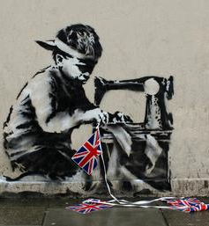
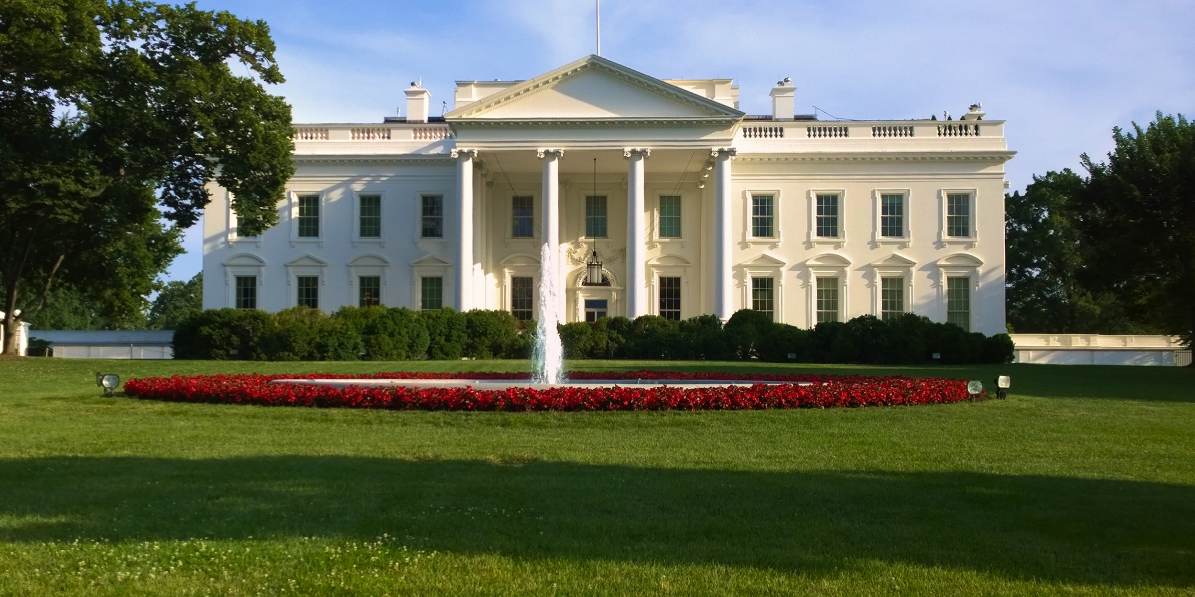
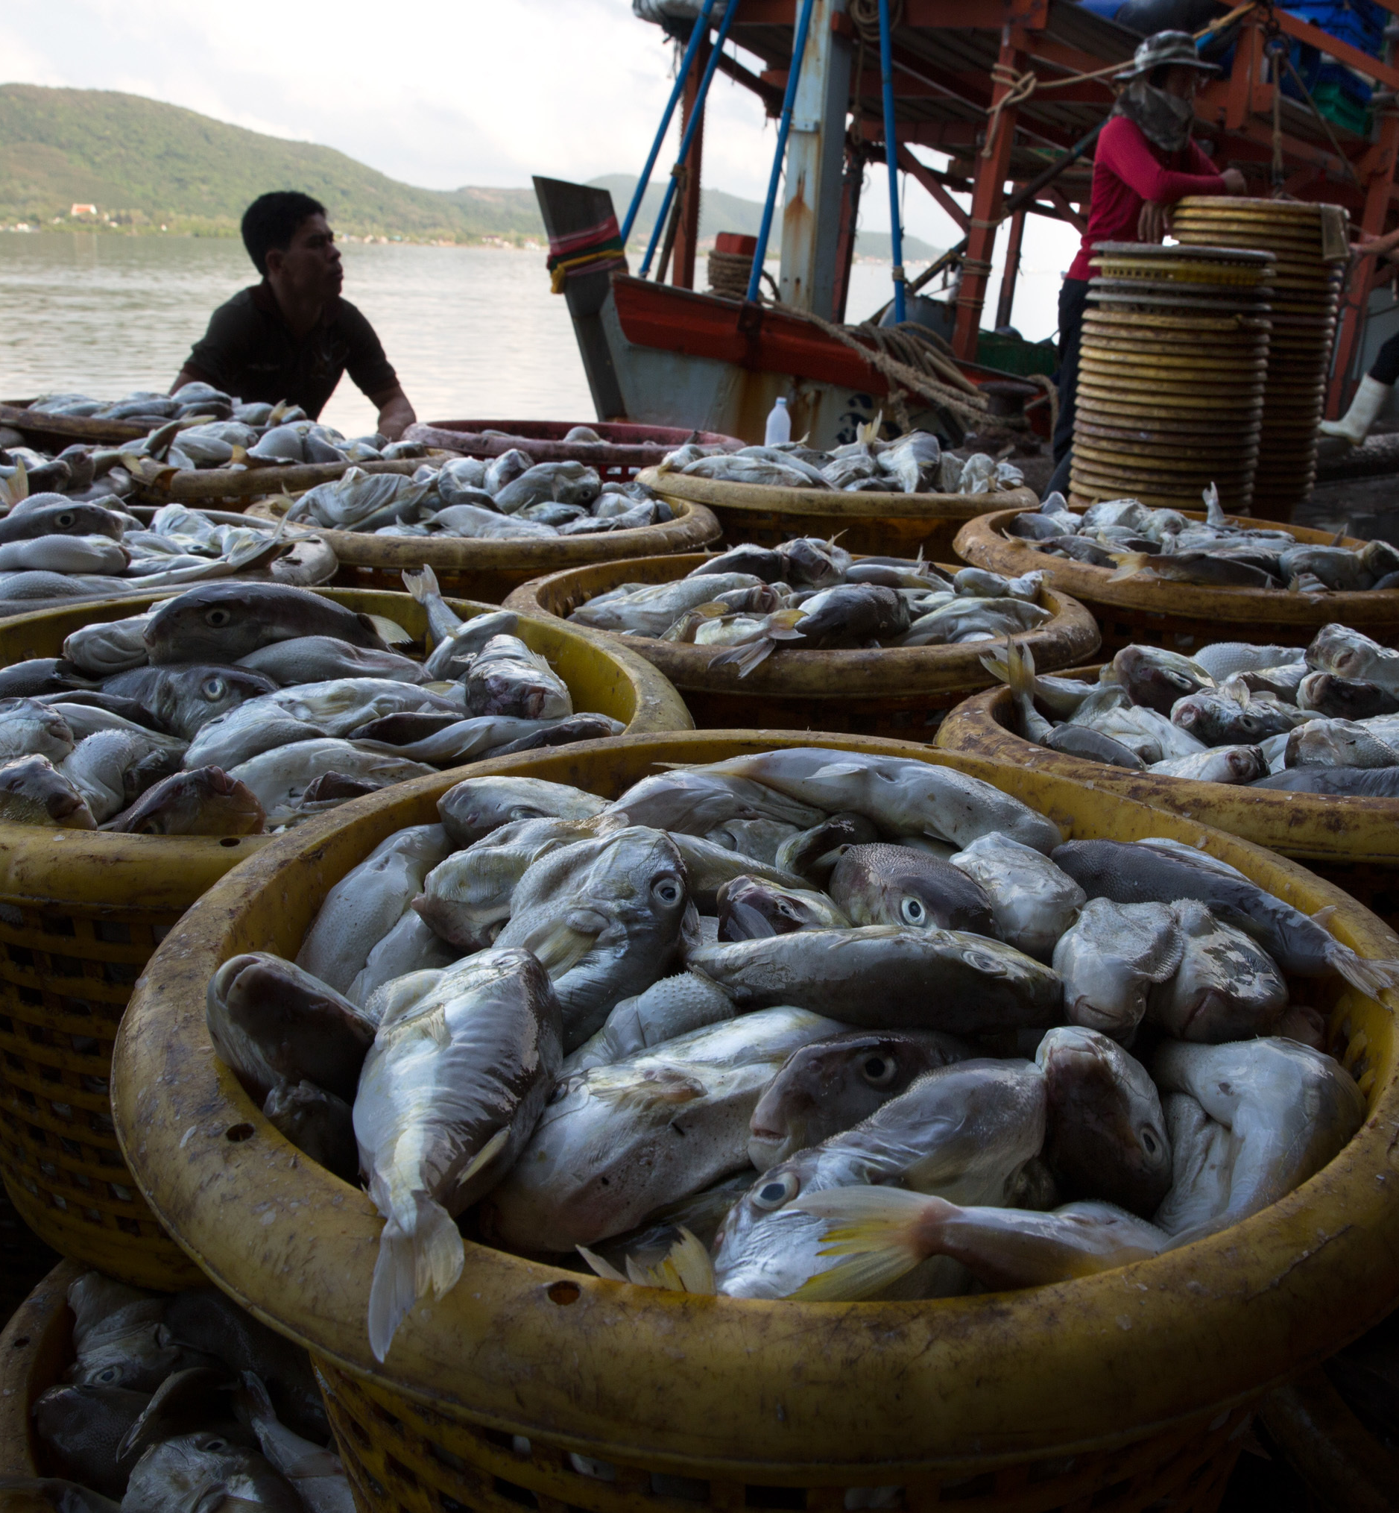
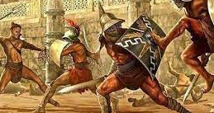
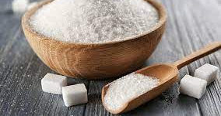
What links these images?

Slide 3
‘There is no more slavery in the world’
Is this true? Think about this statement as we go through today's assembly. We shall revisit it at the end.

Slide 4
What is slavery?
Someone is in slavery if they are:
forced to work – through coercion, or mental or physical threat
owned or controlled by an ’employer’, through mental or physical abuse or the threat of abuse
dehumanised, treated as a commodity or bought and sold as ‘property’
physically constrained or have restrictions placed on their freedom of movement.

Slide 5
Who remembers this?

Slide 7
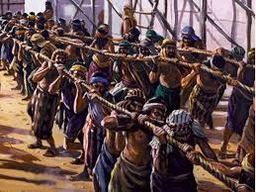
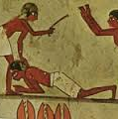
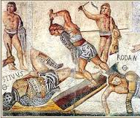
Origins
The idea of slavery is a very old one…
Egyptians.
Romans.
BUT – by 1500 slavery turned into highly profitable international business.

Slide 10
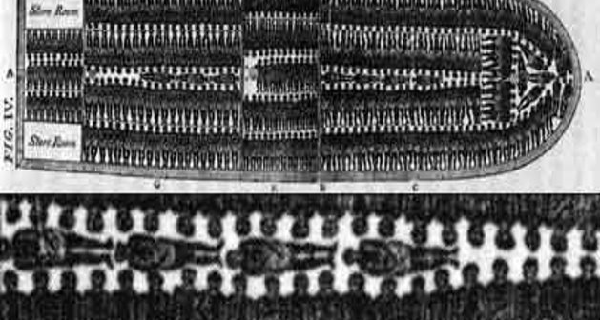
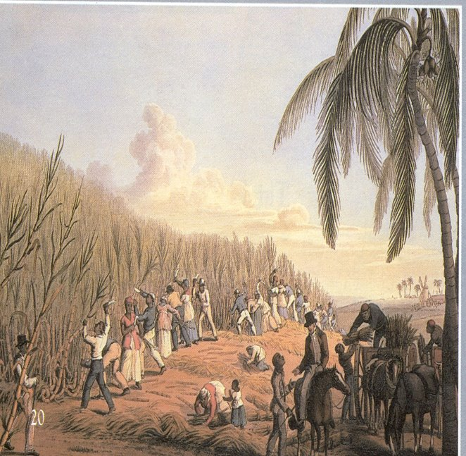
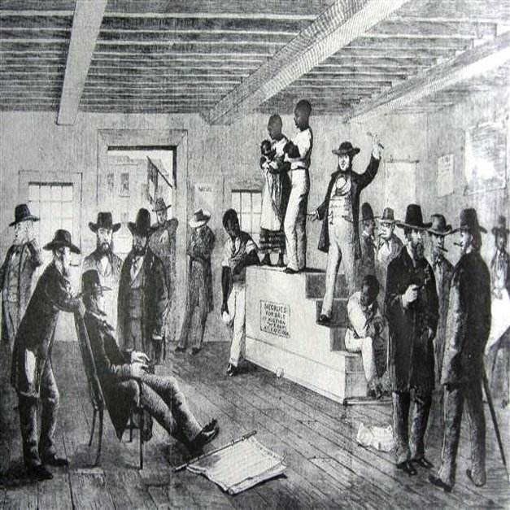

Slide 11
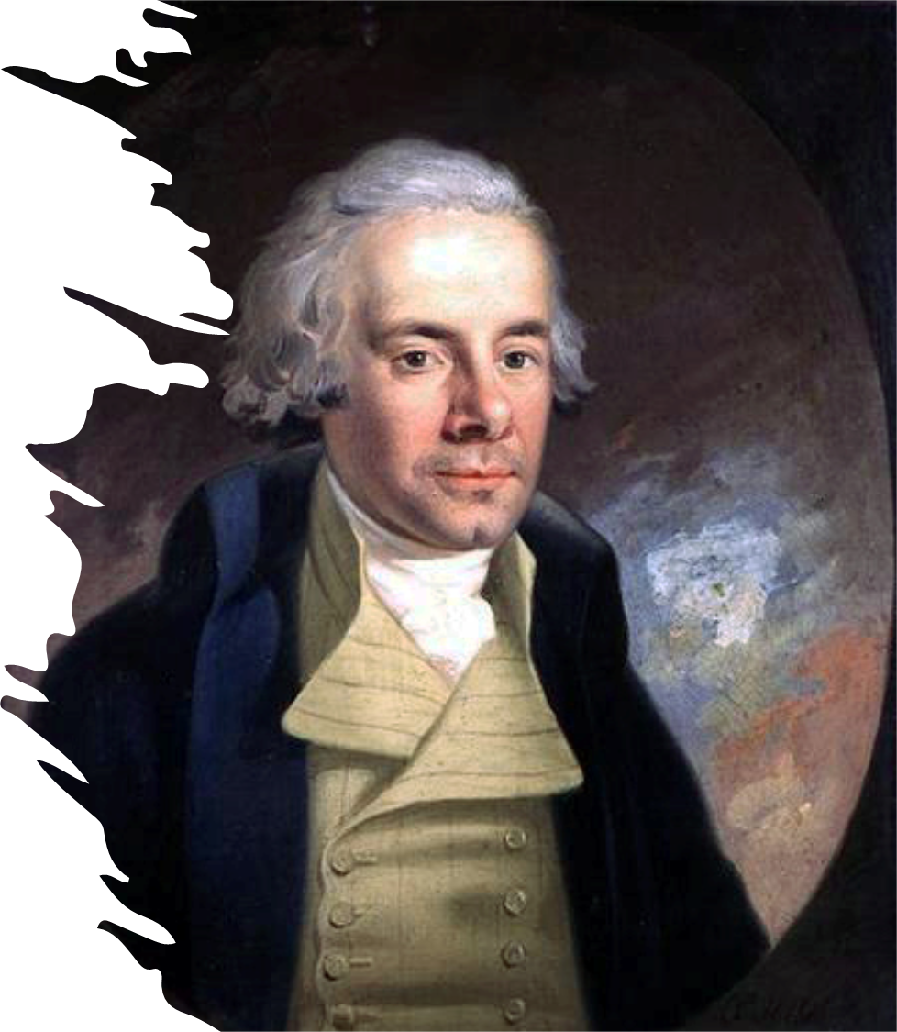
William Wilberforce
In 1807 The slave trade was abolished by the British government. In other words, it was illegal for the trading of slaves to happen… Did this stop slavery?

Slide 12
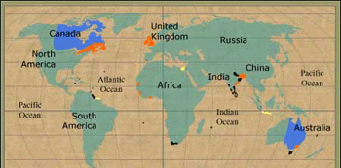
No, it was still legal to own slaves.
However, slavery was made illegal in 1833 in not just Britain but the whole of the British Empire.
Did this mark the end of slavery?

Slide 13
No this didn’t apply to most of the world. However other countries would soon follow in in Britain's footsteps.

Slide 14
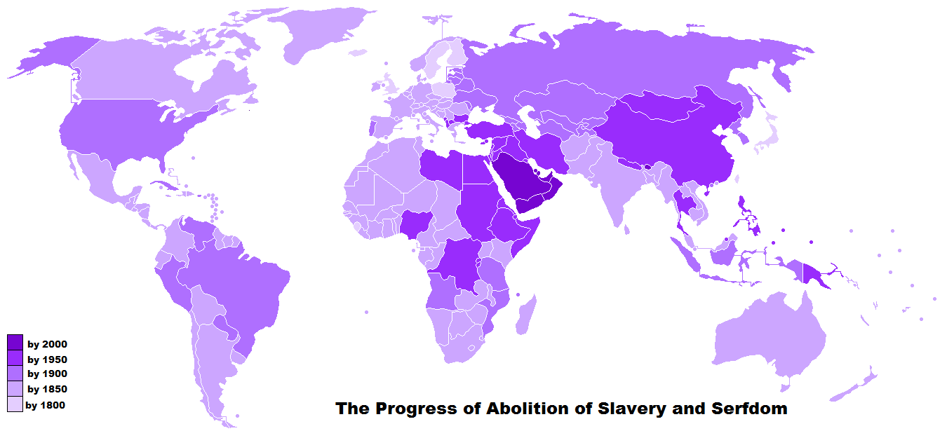
The progress of the abolition of slavery.
Did this mark the end of slavery?

Slide 15
The Universal Declaration of Human Rights

Slide 16
Did this mark the end of slavery?
10 December 1948
The Universal Declaration of Human Rights includes l rights and freedoms for all people.
In Article 4 it states:
“no one should be held in slavery or servitude, slavery in all of its forms should be eliminated.”

Slide 17
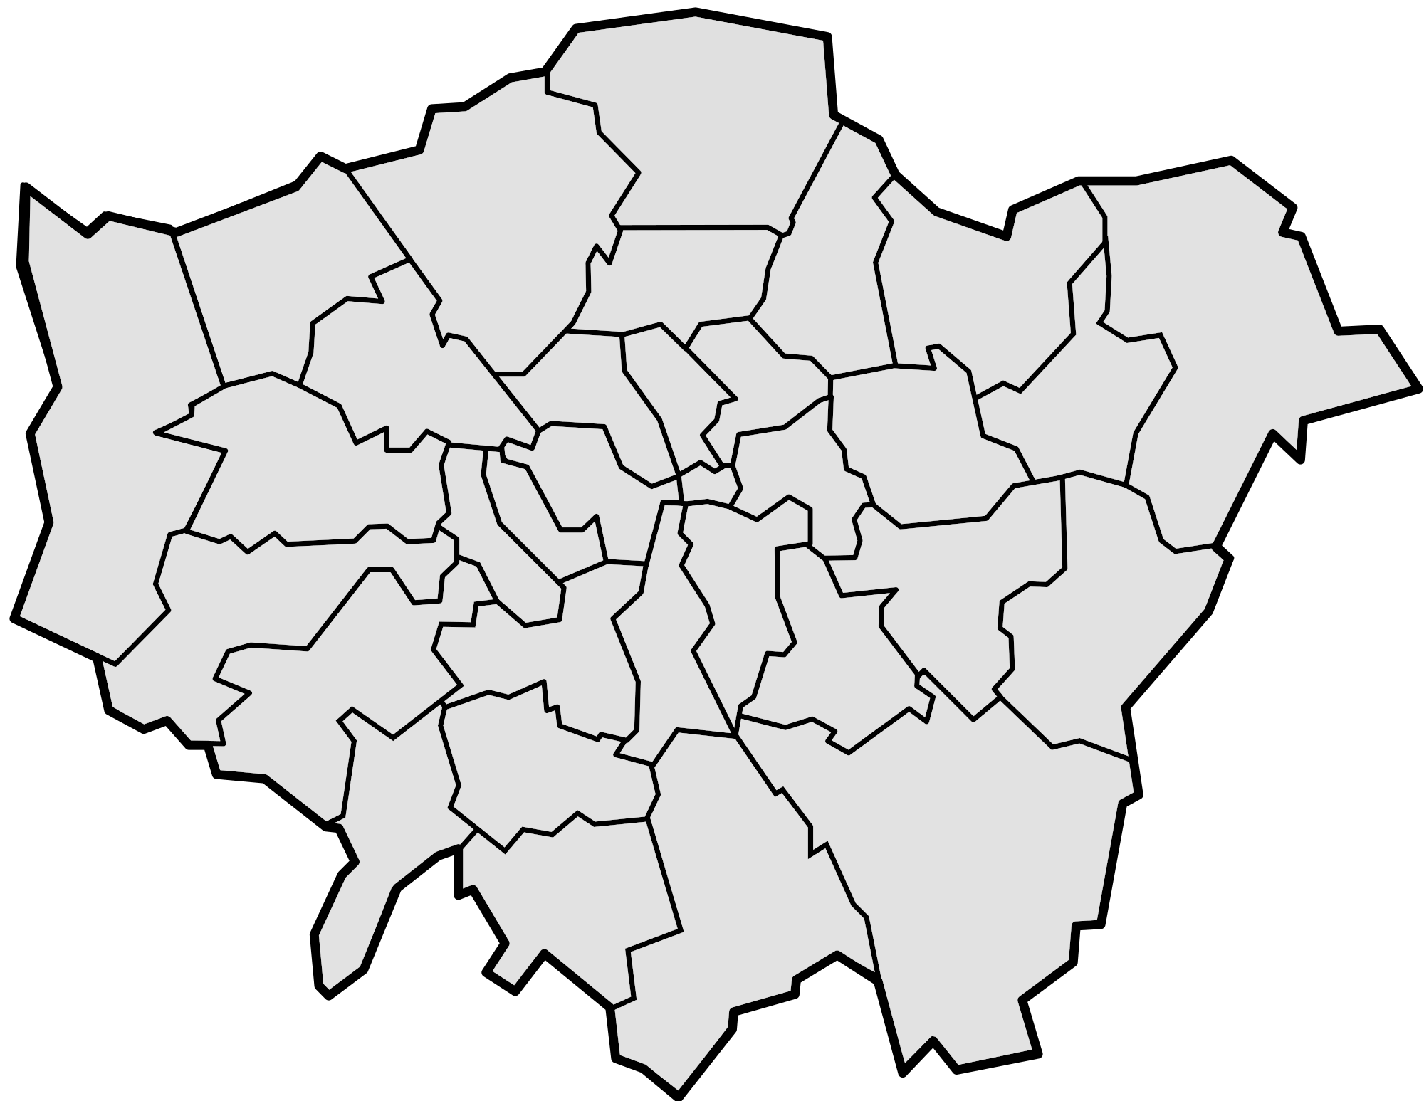
There are more than 40-45 million slaves in the world today
THAT’S MORE THAN 5x THE
POPULATION OF
LONDON...
….OR MORE THAN THE POPULATION OF
ROMANIA AND CHILE COMBINED.
+
+

Slide 18
40 million people are estimated to be trapped in modern slavery worldwide:
1 in 4 of them are children.
Almost three quarters (71%) are women and girls.
Over 10,000 were identified as potential victims by the authorities in the UK in 2019.

Slide 19
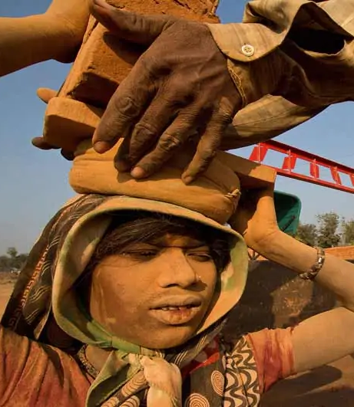
Modern slavery is all around us, but often just out of sight. People can become entrapped making our clothes, serving our food, picking our crops, working in factories, or working in houses as cooks, cleaners or nannies.

Slide 20
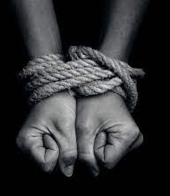
Human trafficking. The use of violence, threats or coercion to transport, recruit or harbour people. This can be done in order to exploit them for purposes such as forced labour, criminality, marriage or for sexual exploitation.

Slide 21
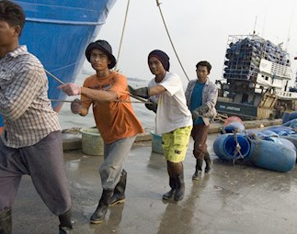
Forced labour. Any work or services people are forced to do against their will under threat of punishment.

Slide 22
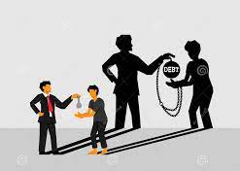
Debt bondage/bonded labour. The world’s most widespread form of slavery. People trapped in poverty borrow money and are forced to work to pay off the debt, losing control over both their employment conditions and the debt.

Slide 23
Descent–based slavery. Most traditional form, where people are treated as property, and their “slave” status was passed down the maternal line.

Slide 24
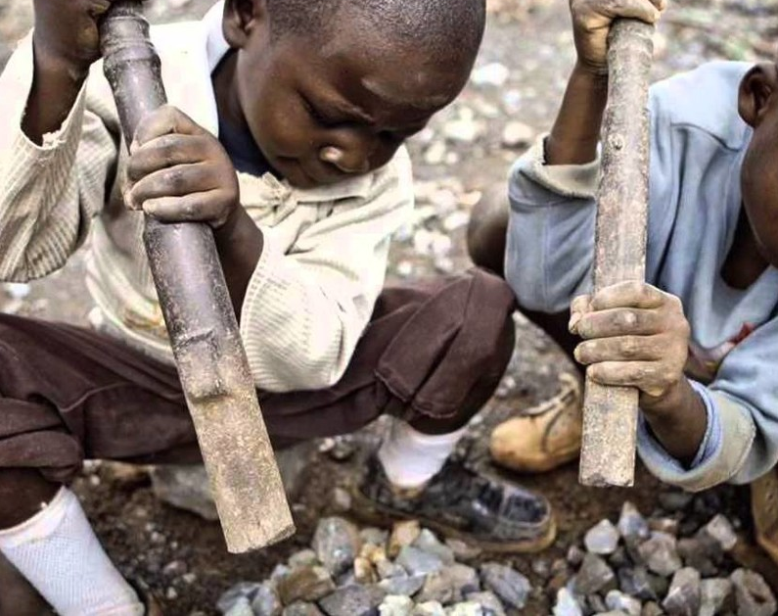
Slavery of children. When a child is exploited for someone else’s gain. This can include child trafficking, child soldiers, child marriage and child domestic slavery.

Slide 25
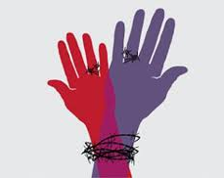
Forced and early marriage.
When someone is married against their will and cannot leave.

Slide 27
Anti-Slavery Day, 18th October, provides an opportunity to raise awareness of human trafficking and modern slavery, and encourage government, local authorities, companies, charities and individuals to do what they can to address the problem.

Slide 28
‘There is no more slavery in the world’
‘There are more people in slavery today than at any other moment in history.’

