Slide 1
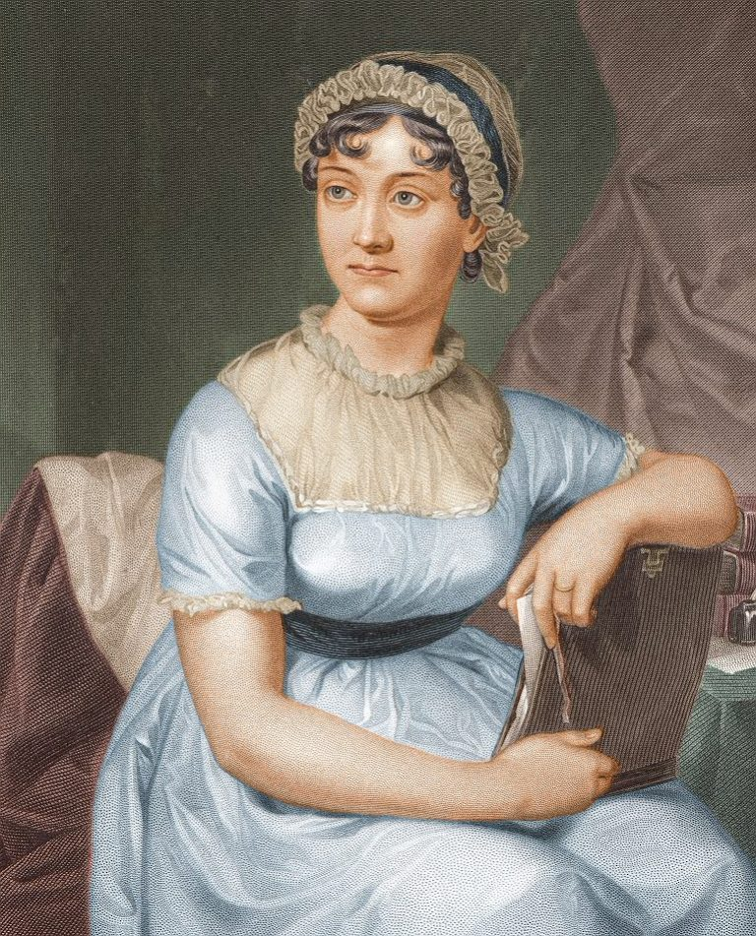
Do you know who this is?
Jane Austen
One of the most famous English writers of all time…and even if you think you haven’t read anything by her or heard of any of her works, the chances are you have come across her in some way, you might just not realise it!

Slide 2
Jane Austen
Mrs Curry

Slide 3
In this assembly…
Learn who Jane Austen was
Learn why she is such an important figure in English Literature
AND there’s a quiz at the end so pay attention! (There are prizes!)

Slide 4
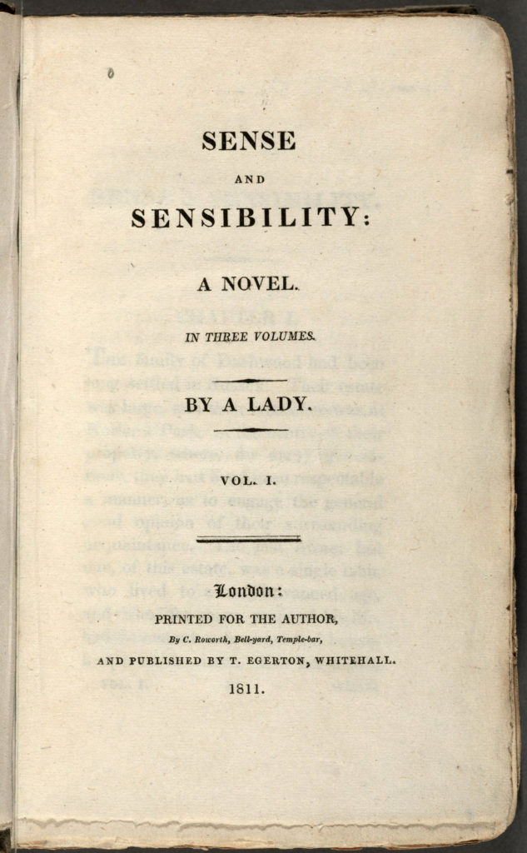
Did you know that Jane Austen… …published all the novels anonymously
Women were seen as wives and mothers and not much more so it made sense to publish anonymously and avoid judgement. Austen was single for her whole life so theoretically should have been dependent on a man financially and socially not making her own money. She wasn’t named as the author for any of her books before she died.
So, she was paving the way for women to have a voice!

Slide 5
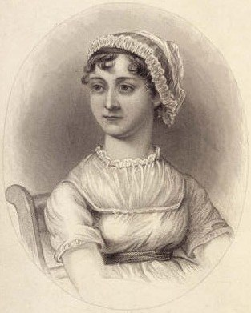
Did you know that Jane Austen… …started writing as a child?
She wrote lots of short stories about things she saw in life, especially people. She loved to bring them to life in writing and started drafting her earliest books when she was a teenager as young as 13.
So, she is proof that you can make a career out of the thing you enjoy doing!

Slide 6
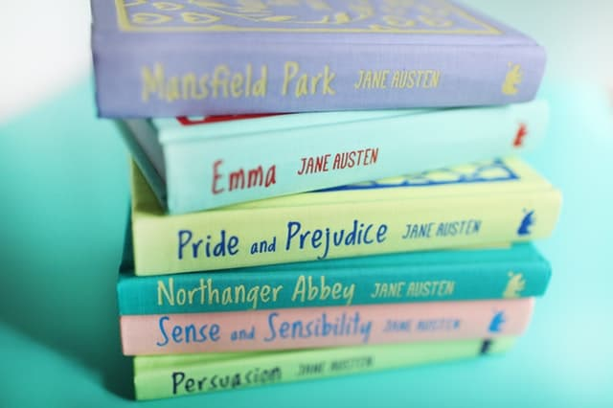
Did you know that Jane Austen… …wrote six complete novels?
Only four of these novels were published whilst she was alive. ‘Northanger Abbey’ and ‘Persuasion’ were published after she died by her family and at this point her brother wrote a note to be published with them acknowledging her as the writer.
So, she is proof that you can be successful sometimes without even knowing it.

Slide 7
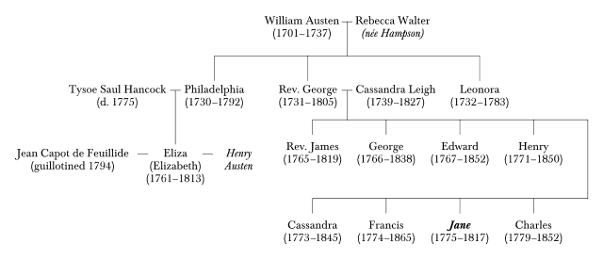
Did you know that Jane Austen… …had seven siblings!
She had one older sister and six brothers. One of her brothers was disabled and required a lot of extra care.
She was very close to her sister and lived with her for her whole life. She talked to her about everything. She writes very fondly about family relationships in most of her books but also about how families can wind each other up.
So, she is evidence that families are sometimes messy and annoying but still form part of who we are.

Slide 8
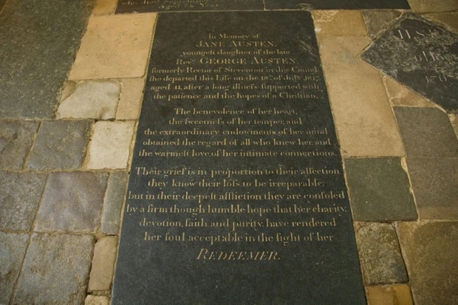
Did you know that Jane Austen… …died when she was only 41 years old
Jane Austen first grew ill in 1816 but lived for a year more before she actually died. Even in her last year of life she started work on a new novel which was published (unfinished) after her death as ‘Sanditon’.
So, she is proof that every moment counts!

Slide 9
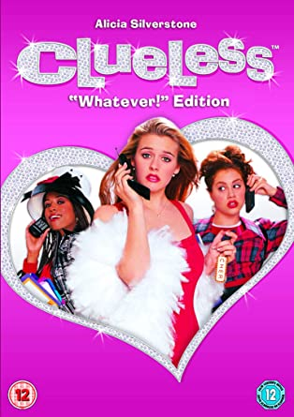
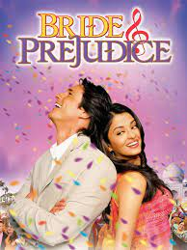

Slide 10
https://www.youtube.com/watch?v=qmd-ej9Hx20&t=74s

Slide 11
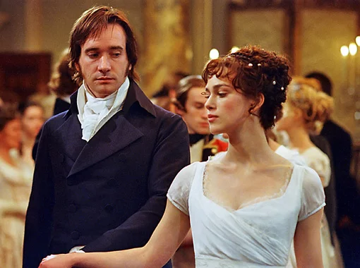
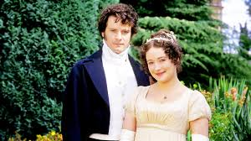
My favourite of hers…Pride and Prejudice
https://www.youtube.com/watch?v=Ur_DIHs92NM

Slide 12
Now…can you remember?
What was Jane Austen’s first novel called?
How old was she when she first started writing?
How many complete novels did she write?
Can you name any of them?
How many siblings did she have?
How old was she when she died?

