Slide 1
Happy international women's day
IWD 2022 campaign theme: #BreakTheBias
Imagine a gender equal world.
A world free of bias, stereotypes, and discrimination.
A world that is diverse, equitable, and inclusive.
A world where difference is valued and celebrated.
Together we can forge women's equality.
Collectively we can all #BreakTheBias.

Slide 2
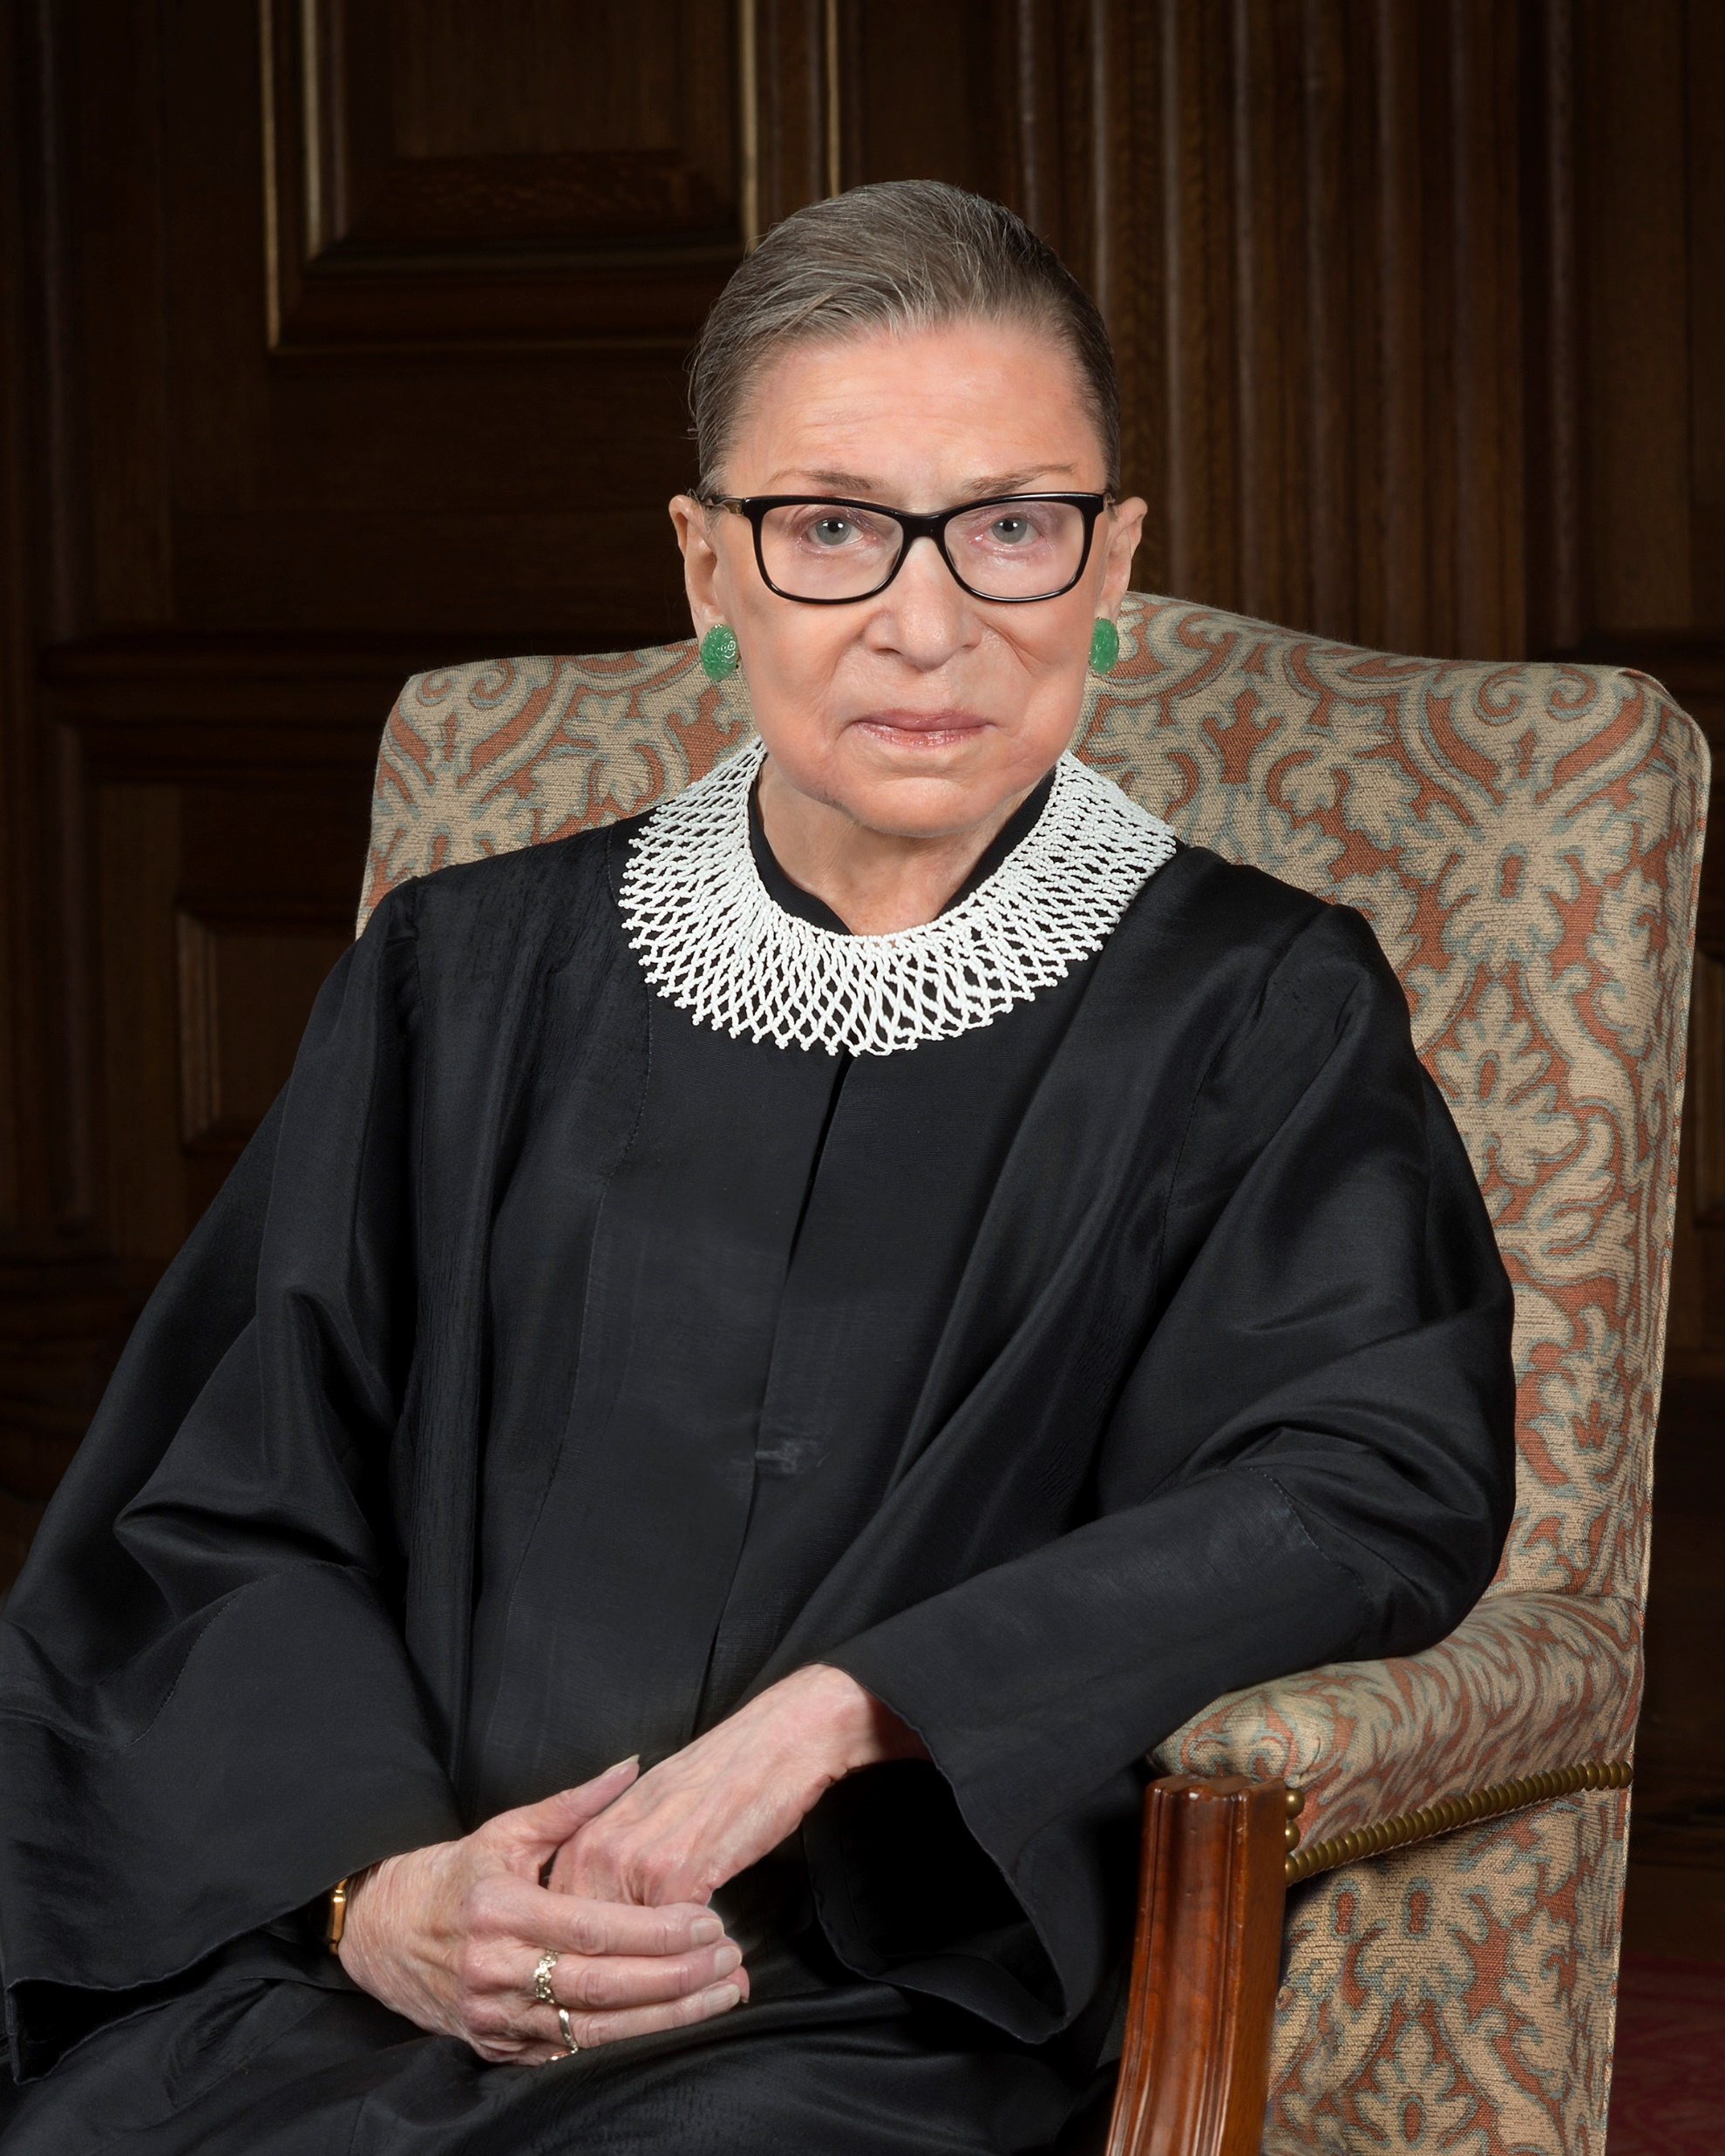
Ruth Ginsburg
Ruth Bader Ginsburg became the second female justice of the U.S. Supreme Court. Born in 1933 in Brooklyn, New York, Bader taught at Rutgers University Law School and then at Columbia University, where she became its first female tenured professor. She served as the director of the Women’s Rights Project of the American Civil Liberties Union during the 1970s, and was appointed to the U.S. Court of Appeals for the District of Columbia in 1980. Named to the U.S. Supreme Court in 1993 by President Bill Clinton, she continued to argue for gender equality
1933 - 2020

Slide 3
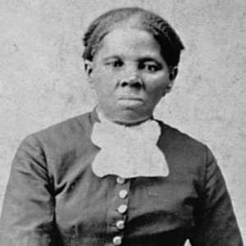
Harriet Tubman
Born into slavery in Maryland, Harriet Tubman escaped to freedom in the North in 1849 to become the most famous "conductor" on the Underground Railroad. Tubman risked her life to lead hundreds of family members and other slaves from the plantation system to freedom on this elaborate secret network of safe houses. A leading abolitionist before the American Civil War, Tubman also helped the Union Army during the war, working as a spy among other roles.
After the Civil War ended, Tubman dedicated her life to helping impoverished former slaves and the elderly. In honor of her life and by popular demand, in 2016, the U.S. Treasury Department announced that Tubman will replace Andrew Jackson on the center of a new $20 bill.
1820 - 1913

Slide 4
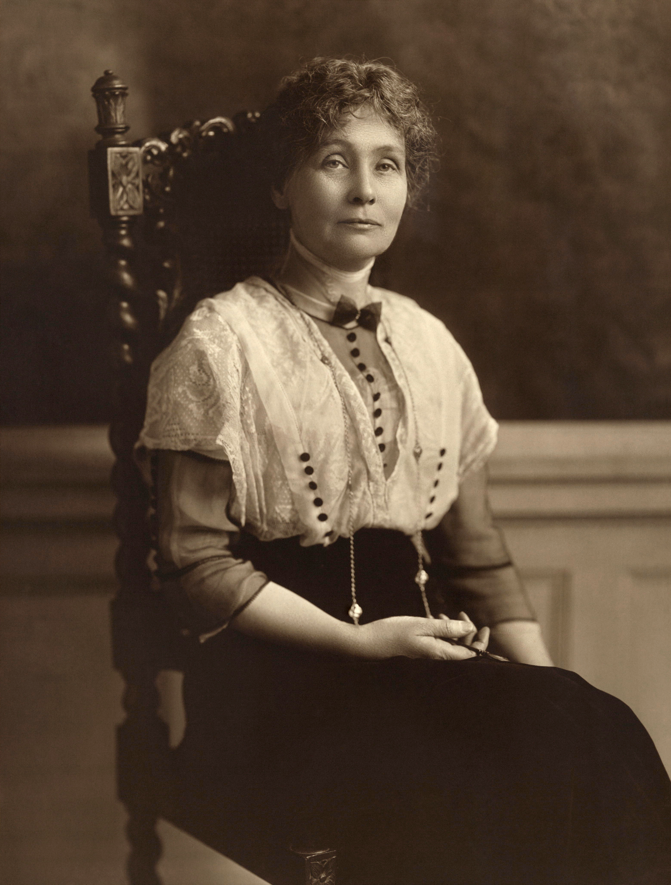
Emmeline Pankhurst
In 1889, Emmeline founded the Women's Franchise League, which fought to allow married women to vote in local elections. In October 1903, she helped found the more militant Women's Social and Political Union (WSPU) - an organisation that gained much notoriety for its activities and whose members were the first to be christened 'suffragettes'. Emmeline's daughters Christabel and Sylvia were both active in the cause. British politicians, press and public were astonished by the demonstrations, window smashing, arson and hunger strikes of the suffragettes. In 1913, WSPU member Emily Davison was killed when she threw herself under the king's horse at the Derby as a protest at the government's continued failure to grant women the right to vote.
1858 - 1928

Slide 5
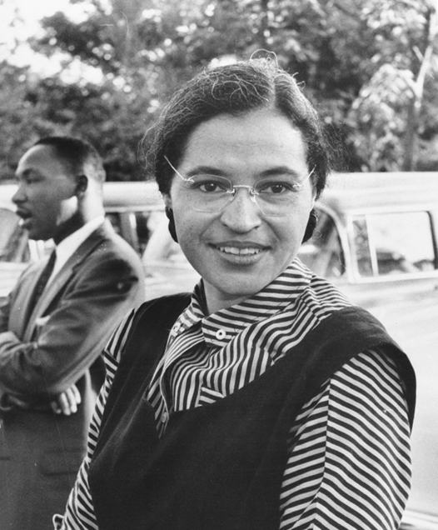
Rosa Parks
Rosa Parks (1913—2005) helped initiate the civil rights movement in the United States when she refused to give up her seat to a white man on a Montgomery, Alabama bus in 1955. Her actions inspired the leaders of the local Black community to organize the Montgomery Bus Boycott. Led by a young Rev. Dr. Martin Luther King Jr., the boycott lasted more than a year—during which Parks not coincidentally lost her job—and ended only when the U.S. Supreme Court ruled that bus segregation was unconstitutional. Over the next half-century, Parks became a nationally recognized symbol of dignity and strength in the struggle to end entrenched racial segregation.
1913 -2005

Slide 6
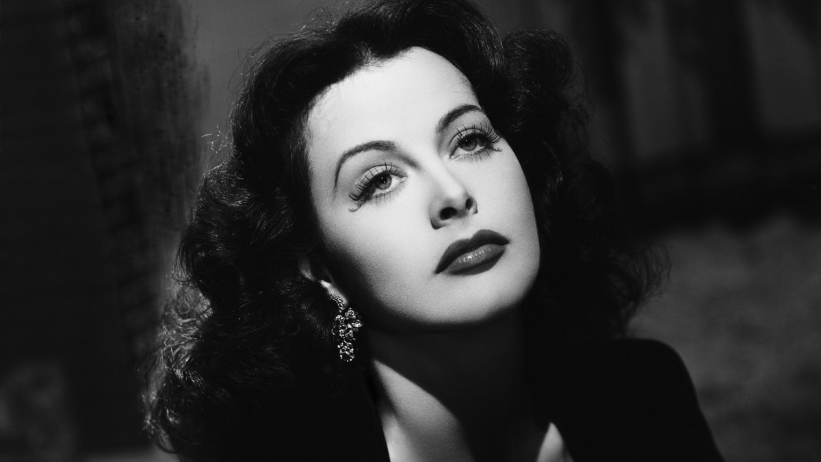
Hedy Lamarr
Often called “The Most Beautiful Woman in Film,” Hedy Lamarr was more than what met the eye. While Lamarr’s screen presence made her one of the most popular actresses of her day, she was also an inventor with a sharp mind. Along with avant-garde composer George Anthiel, Lamarr developed a new method of “frequency hopping,” a technique for disguising radio transmissions by making the signal jump between different channels in a prearranged pattern

Slide 7
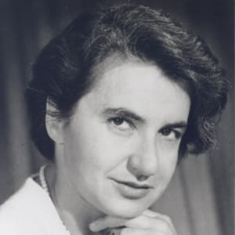
Rosalind Franklin
Rosalind Franklin earned a Ph.D. in physical chemistry from Cambridge University. She learned crystallography and X-ray diffraction, techniques that she applied to DNA fibers. One of her photographs provided key insights into DNA structure. Other scientists used it as evidence to support their DNA model and took credit for the discovery. Franklin died of ovarian cancer in 1958, at age 37.
1920 - 1958

