Slide 1

Whithaugh Park Information Evening
4th May 2022

Slide 2
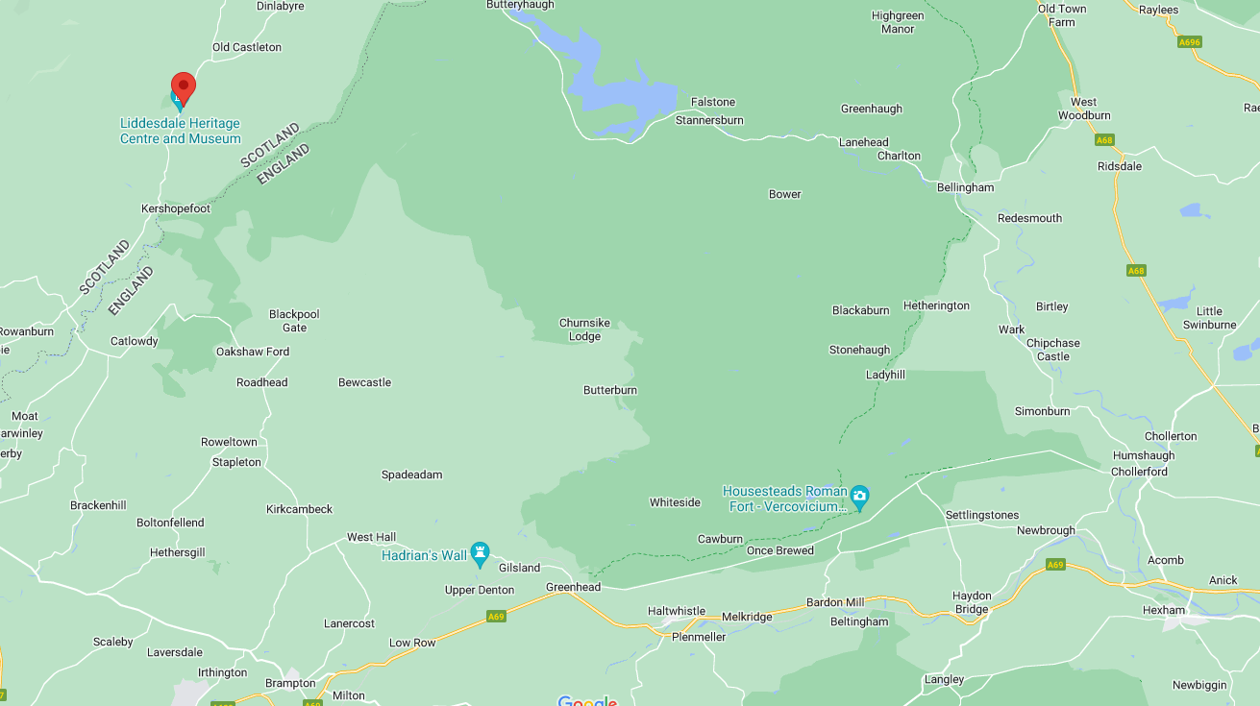
Whithaugh Park Information
Location:
Travel Time –
(approx.) 1 Hour 20 minutes.
Whithaugh Park residential centre is situated in the unspoilt landscape of the Scottish Borders countryside and shares its surroundings with forests and rivers. The centre is a popular choice for group accommodation, outdoor activities and school trips.

Slide 3
Whithaugh Park Information
At Whithaugh Park we focus on really making a difference to every child that visits us. Rather than numbers through the door, our goal is to provide quality educational school trips and memories that last a lifetime.
For many children this is the first significant time they’ve spent away from home, but by the end of their school residential adventure trip their confidence will have grown massively.
Our instructors are really good at working with young children and helping them overcome fears and challenges to bring out a completely different side, which teachers may not have seen before.

Slide 4
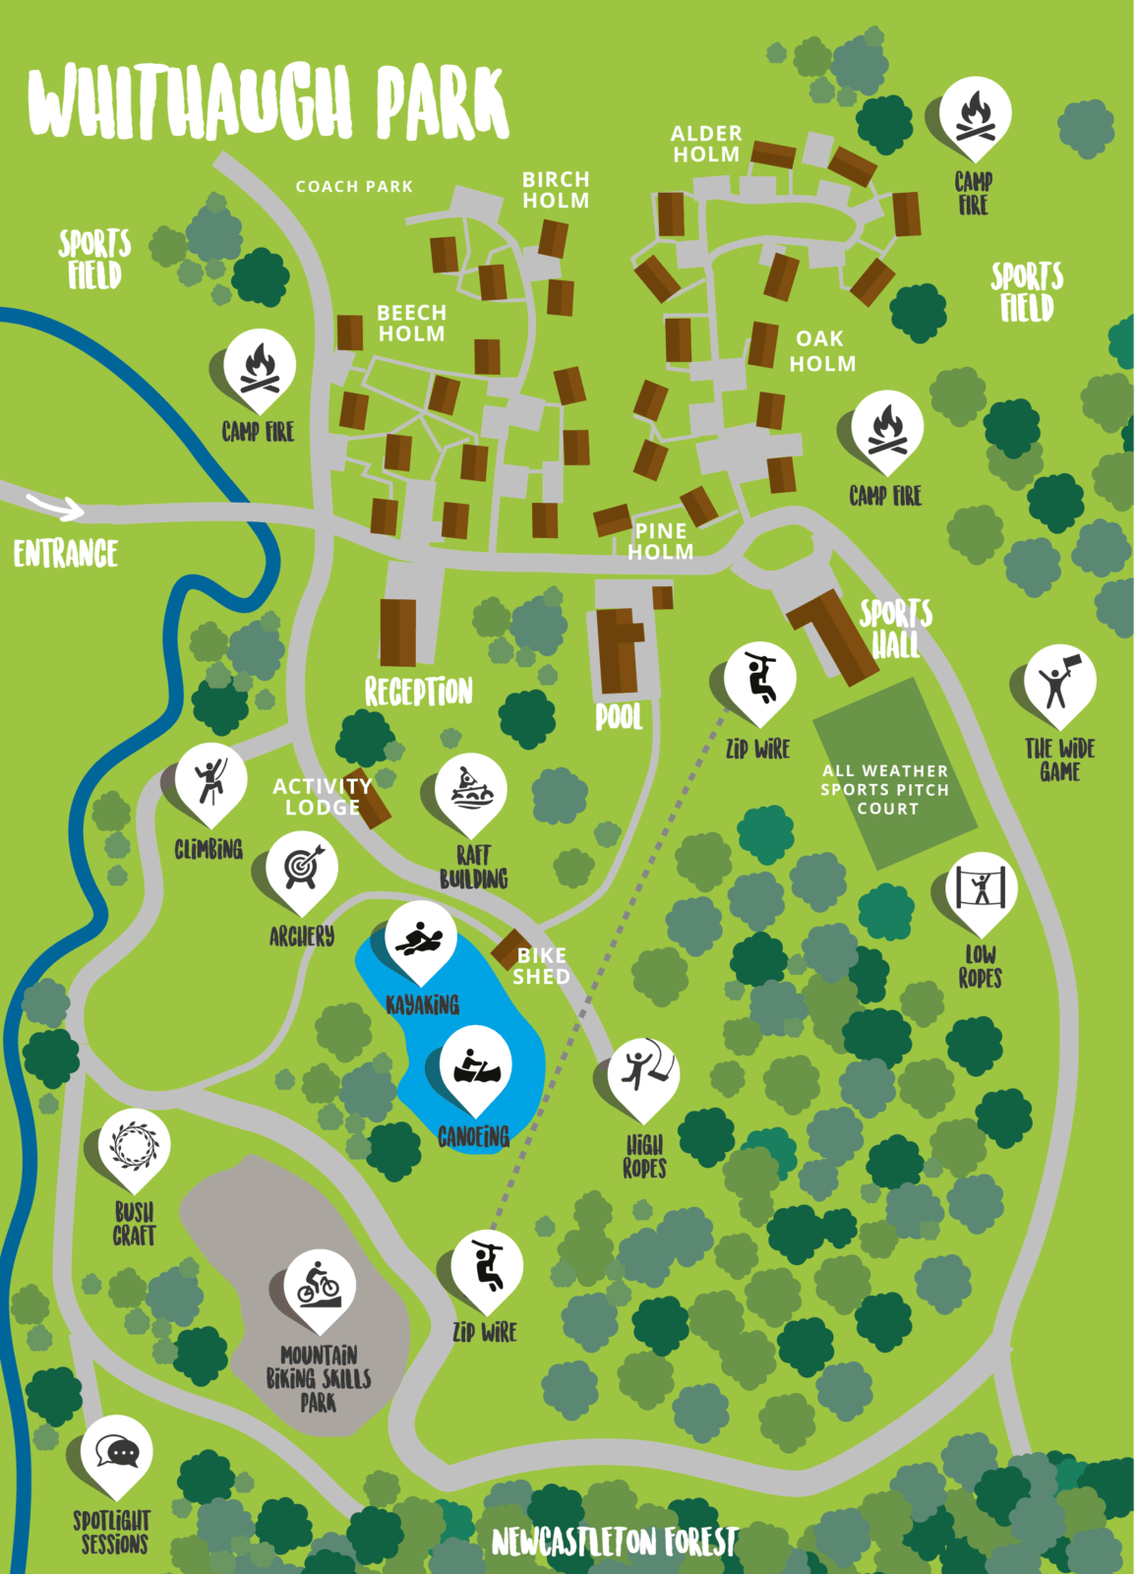
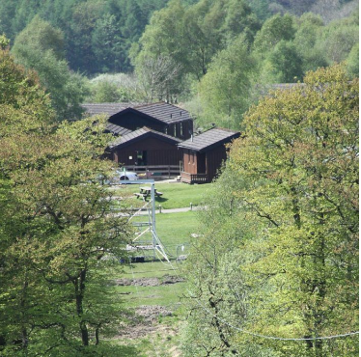
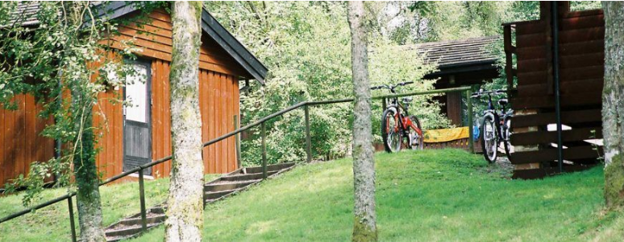
The site:-
Consists of a mixture of cabins and tented accommodation. We will be staying in the cabins.
All of the activities we will be completing are self-contained and take place within the complex.
We will have access to the all-weather sports pitch, zip wire, swimming pool and the rest of the facilities.
Meals including breakfast and packed lunches, dinner and supper will be provided.
Dietary requirements will need to be completed on Google Form to follow.

Slide 5
Our Trip
General Information
Y5 trip will be staffed by the Y5 tutor team, Mr Stephenson, Mrs Curry and LSAs.
Y6 trip will be staffed by Y6 tutor team (except Mrs Alderson), Mr Stephenson, Mr Freeman Myers and LSAs.
Mr Stephenson will be lead on both trips and will carry the school emergency phone. More information will be sent out in a letter containing this number.
Students will be allowed to bring one “hand luggage sized” bag containing all of their belongings.
Students will be allowed their mobile phone for the trip. Guidance will be given to students regarding when this can be used. Students should not bring any other technology or equipment as I cannot guarantee its safety and neither will we, or Whithaugh Park accept liability for any damage or loss of personal belongings.
Students can bring their own snacks should they wish to – but please limit this as all meals are provided.
Students can bring a small amount of money (no more than £10) as there is a shop on site selling drinks and confectionary. Again, students do so at their own risk.
No jewellery.

Slide 6
Itinerary - Logistics
Y6 – Monday 23rd May – Wednesday 25th May
Y5 – Monday 6th June – Wednesday 8th June
Day One
8.40 – Arrival at school and registration in form groups. Organisation to take place in Fellside Hall.
Before 10.00am – Students leave school site.
11.30/12.00 – Arrival at Whithaugh Park, Newcastleton. Lunch upon arrival. Pupils assigned lodges and groups.
13.45 – Activity 1
15.45 – Activity 2
18.00 – Dinner – 2 course meal with vegetarian options.
19.30 – Activity 3
21.15 – Supper – hot chocolate and other snacks
21.30 – Bed and Sleep!

Slide 7
Itinerary - Logistics
Day Two
8.00 – Breakfast – self service – fruit juice, cereal selection, toast, jams, yoghurt, fruit etc.
9.00 Activity 4
11.00 Activity 5
12.45 – Lunch – Packed lunch – sandwiches, cup-a-soups, fruit, crisps, drinks etc.
13.45 Activity 6
18.00 Dinner
19.30 Activity 7
21.15 – Supper
21.30 – Bed and Sleep!

Slide 8
Itinerary - Logistics
Day Three
8.00 – Breakfast
9.00 – Depart from lodges
10.00 – 12.00 Use of facilities – all weather pitch/recreational lodge
12.00 – Packed lunch
12.45 – Leave to return to school
14.00 – Return to school and collection.

Slide 9
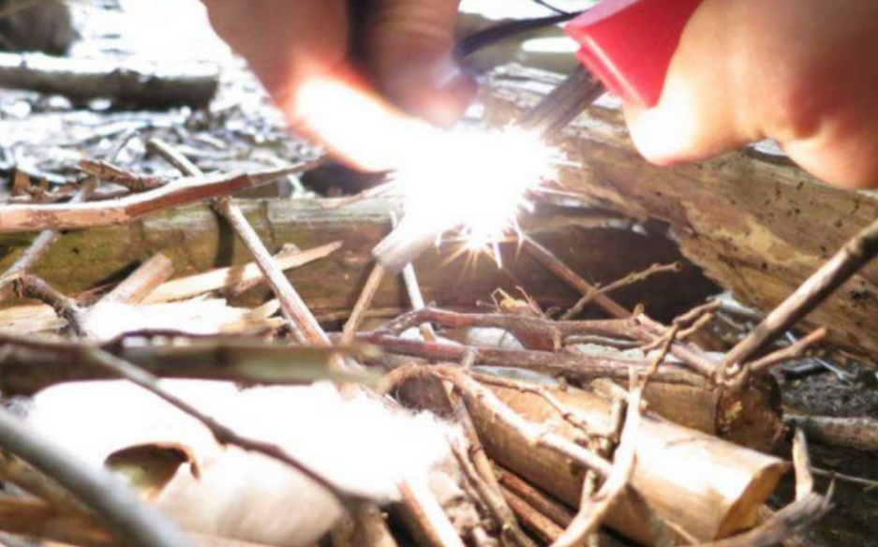
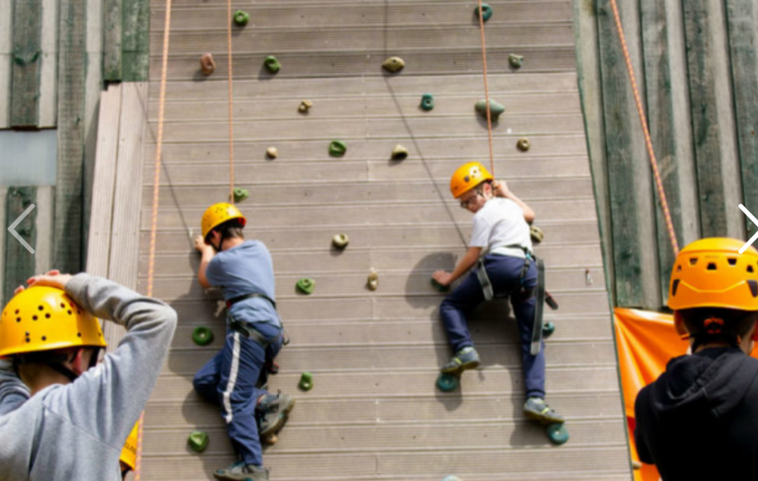
Activities
Having been split into groups students will complete 7 of the following activities across the three days:-
Bushcraft
Climbing
Night Hike
Open Canoe
Raft Building
Self-led team building
Swimming (indoor pool)
Zip Wire

Slide 10
Accommodation and Groupings
Whilst staff will endeavor to ensure students are with social groups etc, it may not be possible to ensure that every student is with all of their social group at all times.
Mr Stephenson and the team will assign accommodation and groupings as fairly and as sensibly as we can.
The primary concern is that all students have a fun, productive and restful time away and we will assign groups accordingly.
Please email Mr Stephenson directly with any concerns regarding this.

Slide 11
Kit List/what to pack
Medical – Any inhalers, daily medicines/tablets (please inform Mr Stephenson directly about these)
Kit – (all may become wet – please pack accordingly)
Old spare trainers and dry trainers (wellies)
Indoor shoes
Suitable nightwear
Swimming costume
Trousers/shorts for activities (not jeans for activities)
T-Shirts (enough for three days with some becoming wet)
Underwear
Warm hat, gloves, coat etc.
Warm jumpers
Waterproof jacket
Bag for muddy kit (I’ll be bringing bin bags!)
Drinks bottle
Torch
Towels for showering and activities (2)
Wash bag containing soap, shampoo, toothpaste, toothbrush.
Specific full change of clothes for after the raft building session – they will get wet!
PLEASE ENSURE THAT ALL ITEMS ARE CLEARLY MARKED AND LABELLED WITH YOUR CHILD’S NAME!

Slide 12
To do –
Complete the google form relating to medical, swimming ability and pick up arrangements for return.
Pack!
Contact Mr Stephenson (mstephenson@hexhammiddle.org.uk) with any queries. I will endeavor to answer them ASAP.
I am aware that some students may find it difficult being away from home – we will endeavour to do all that we can to ensure every single child enjoys their trip and remains with us. Should there be any issue, which we cannot solve and require parents/carers to pick up their child then we will contact you and ensure safety and supervision until your arrival.
Medical Emergency –
Doctors Bowley and Kennedy (local doctors near Newcastleton)
Casualty Department Cumberland Infirmary Carlisle (25 miles)

