Slide 1
"Become Aware and Care"
Mental Health and Emotion Coaching Workshop
Parent/carer engagement Session
28 November 2022

Slide 2
Intentions
In today’s session we will:
understand what mental health is and isn't
appreciate the current context of mental health
be able to identity signs and symptoms of poor mental health
know what Emotion Coaching involves, how this is being used at HMS, and how it could be used outside school to help the self-regulation of challenging emotions of pupils.
Learn more about resources to support mental health

Slide 3
What is Mental Health?
“Mental health is a state of mental well-being that enables people to cope with the stresses of life, realise their abilities, learn well and work well, and contribute to their community.
It is an integral component of health and well-being that underpins our individual and collective abilities to make decisions, build relationships and shape the world we live in. Mental health is a basic human right. And it is crucial to personal, community and
socio-economic development.”
World Health Organisation, 2014

Slide 5
Facts and figures
One in six children aged five to 16 were identified as having a probable mental health problem in July 2021, a huge increase from one in nine in 2017. That’s five children in every classroom (i).
The number of A&E attendances by young people aged 18 or under with a recorded diagnosis of a psychiatric condition more than tripled between 2010 and 2018-19 (ii).
83% of young people with mental health needs agreed that the coronavirus pandemic had made their mental health worse (iii).
Suicide was the leading cause of death for males and females aged between five to 34 in 2019 (v).
https://www.youngminds.org.uk/about-us/media-centre/mental-health-statistics/

Slide 6
Young people need more support
Just over 1 in 3 children and young people with a diagnosable mental health condition get access to NHS care and treatment.
In a YoungMinds survey, three-quarters (76%) of parents said that their child's mental health had deteriorated while waiting for support from Child and Adolescent Mental Health Services (CAMHS).
In a YoungMinds commissioned survey by Censuswide, two-thirds (67%) of young people said they would prefer to be able to access mental health support without going to see their GP but half (53%) said they didn't know how else to access this help

Slide 7
Signs and symptoms of poor mental health?
Feeling of stress, anxiety or worry
Feelings of sadness or depression
Lack of self-confidence and loneliness
Having difficulty falling asleep and staying asleep
Not wanting to join in activities you previously enjoyed
Frequent outbursts and inability to calm down

Slide 8
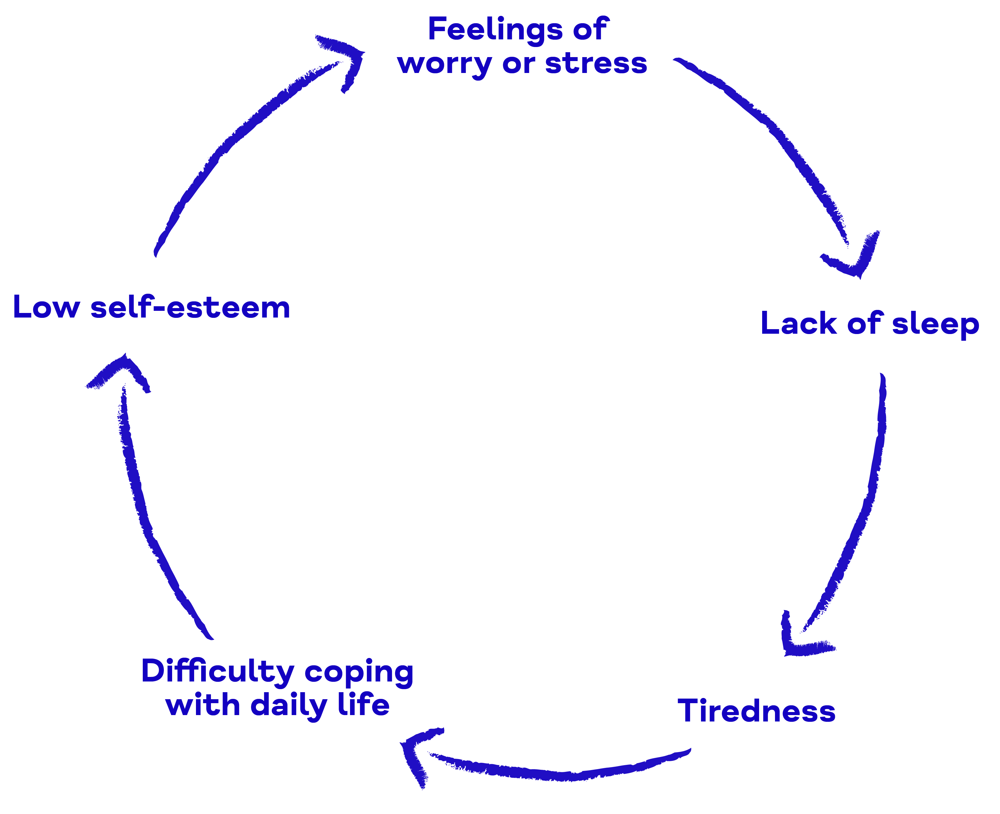
The link between sleep and mental health

Slide 9
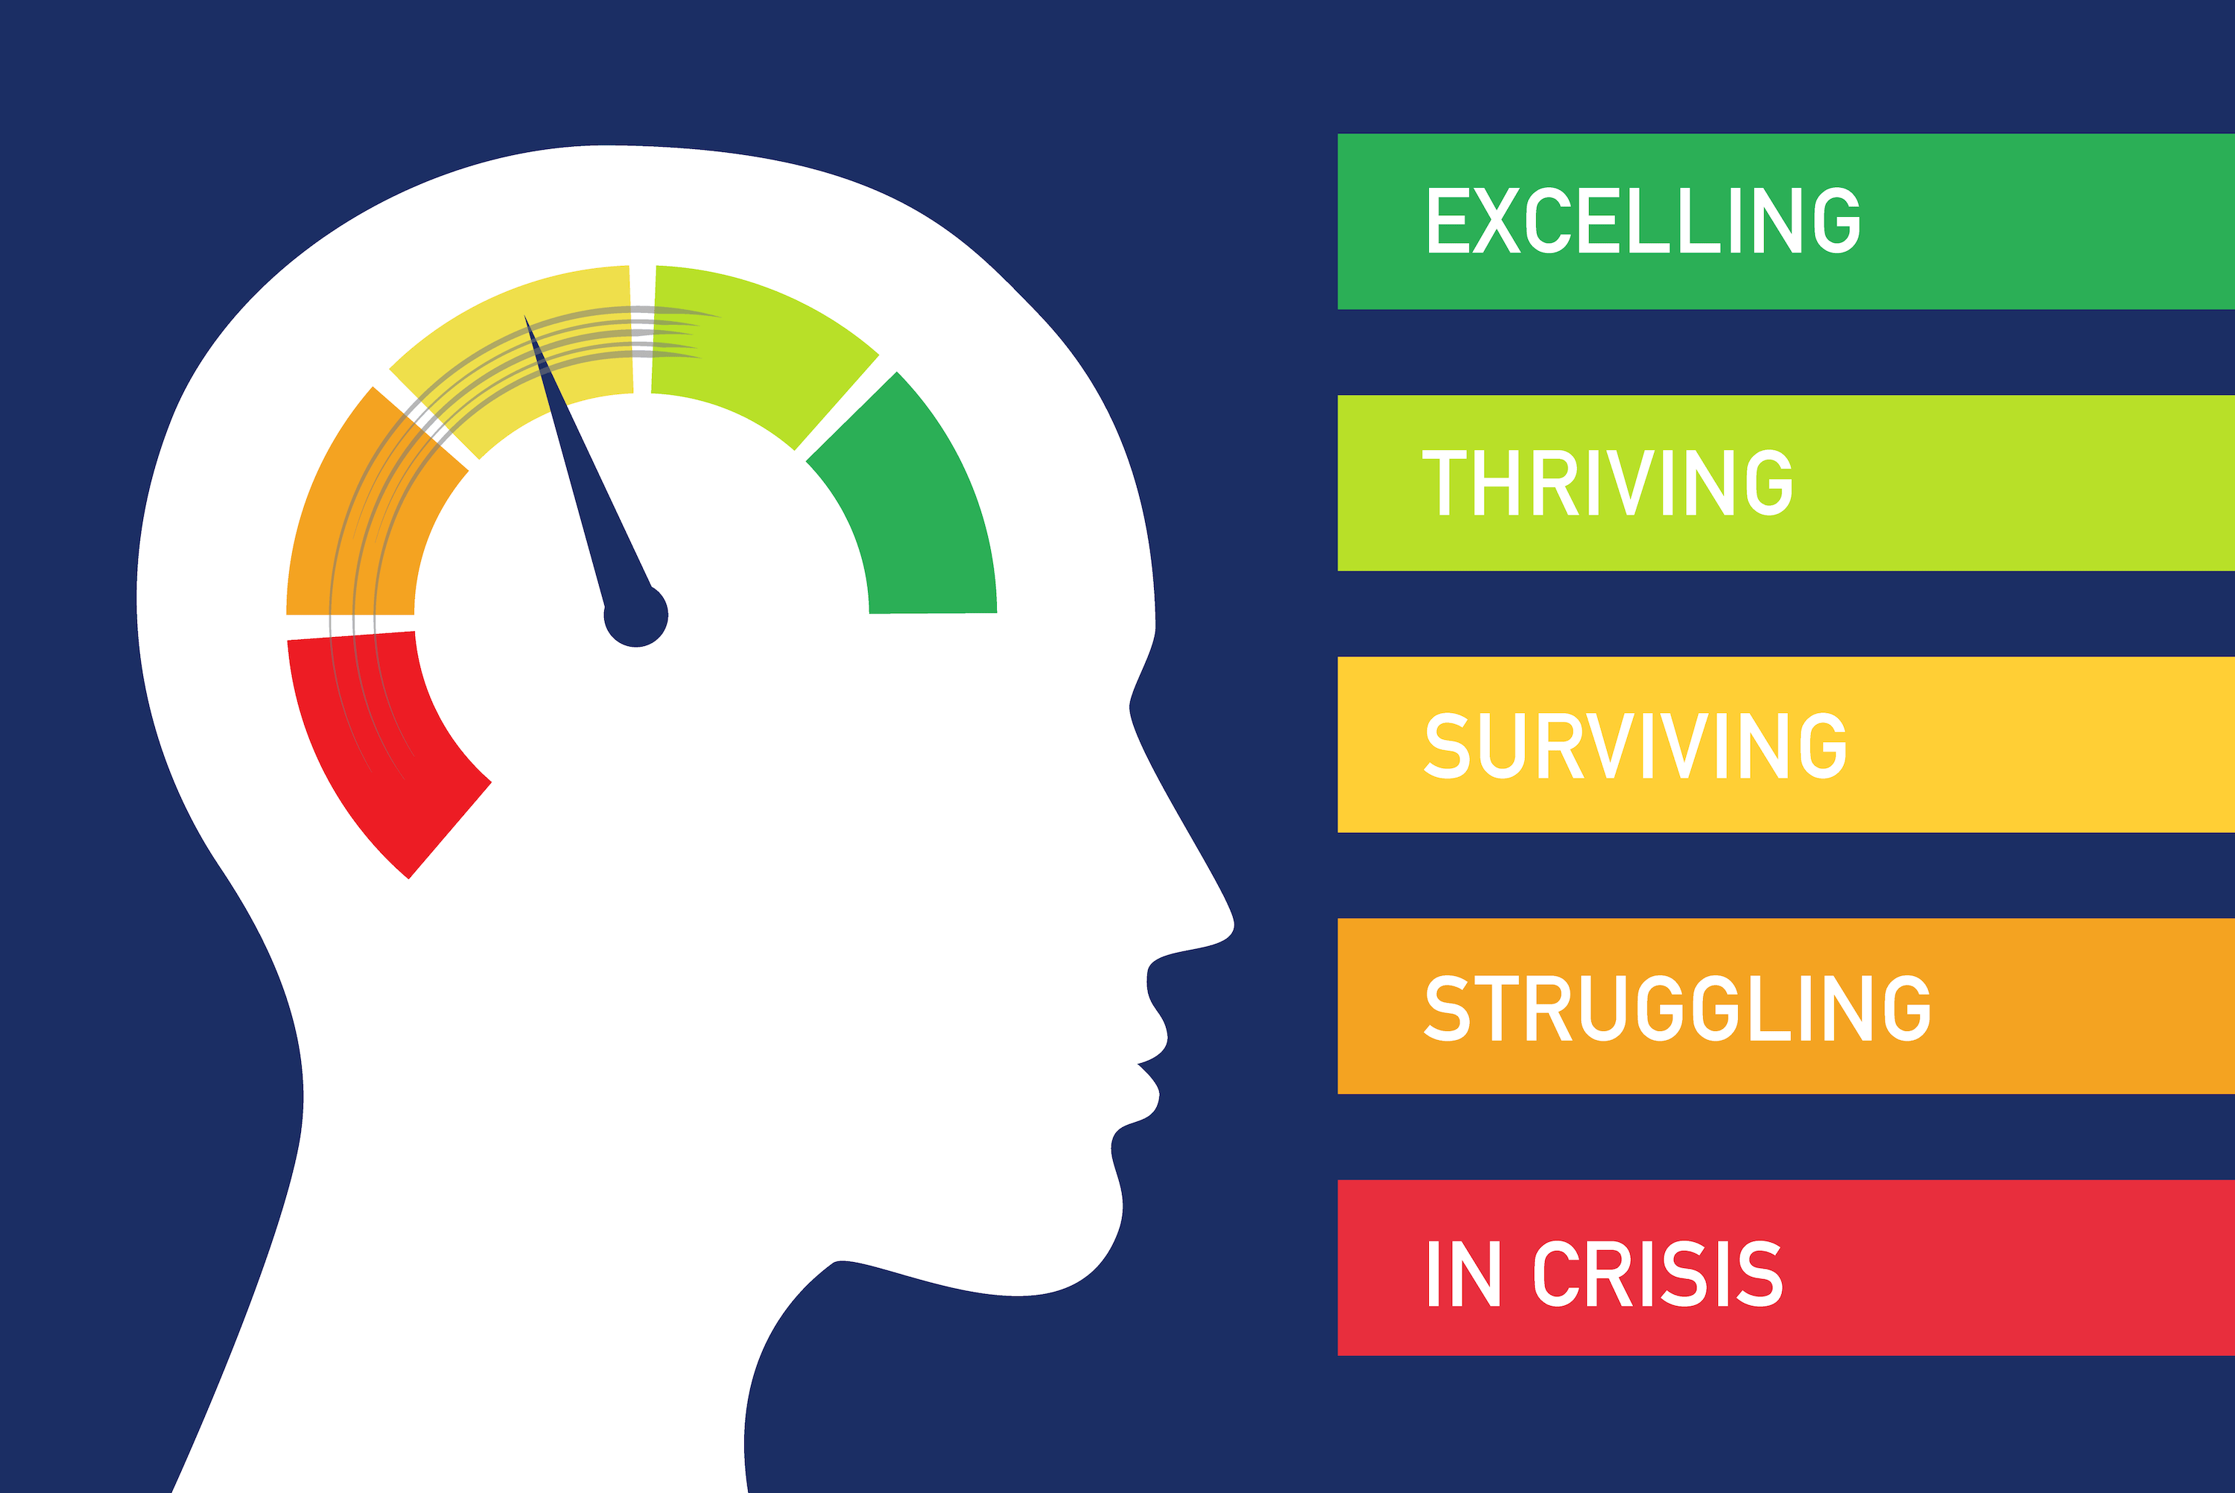
How do we know if our mental health is good?

Slide 11
I can't control:
I can control:
What other people think or do
Other people's opinions
The future
The weather
How others respond or react
If people like or dislike me
The past
Other people's happiness
Other people's motives
What happens around me
My attitude
My boundaries
The choices I make
Being adaptable to change
The way I act
How I express myself
My thoughts and actions
Where I put my time and energy
How I respond
The way I treat others
My words
My beliefs and values

Slide 12
Emotion Coaching
Promoting:
positive behaviour
Wellbeing
Resilience

Slide 13
Let's think of a time when ...
… you felt angry.
When was this?
Where were you?
Were you with someone else or alone?
What actually happened to make you feel angry?
How did you react?
What made your anger subside?
How long did it take you for the angry to go away? Has it gone away?

Slide 14
Think of a time when your child felt angry.
How does their behaviour manifest when they get angry?
They get agitated
Face reddens
Lots of shouting/swearing
Verbal abuse of other people
Physical aggression (towards other people, themselves or nearby objects)
Withdrawing/silence
Teary and upset

Slide 15
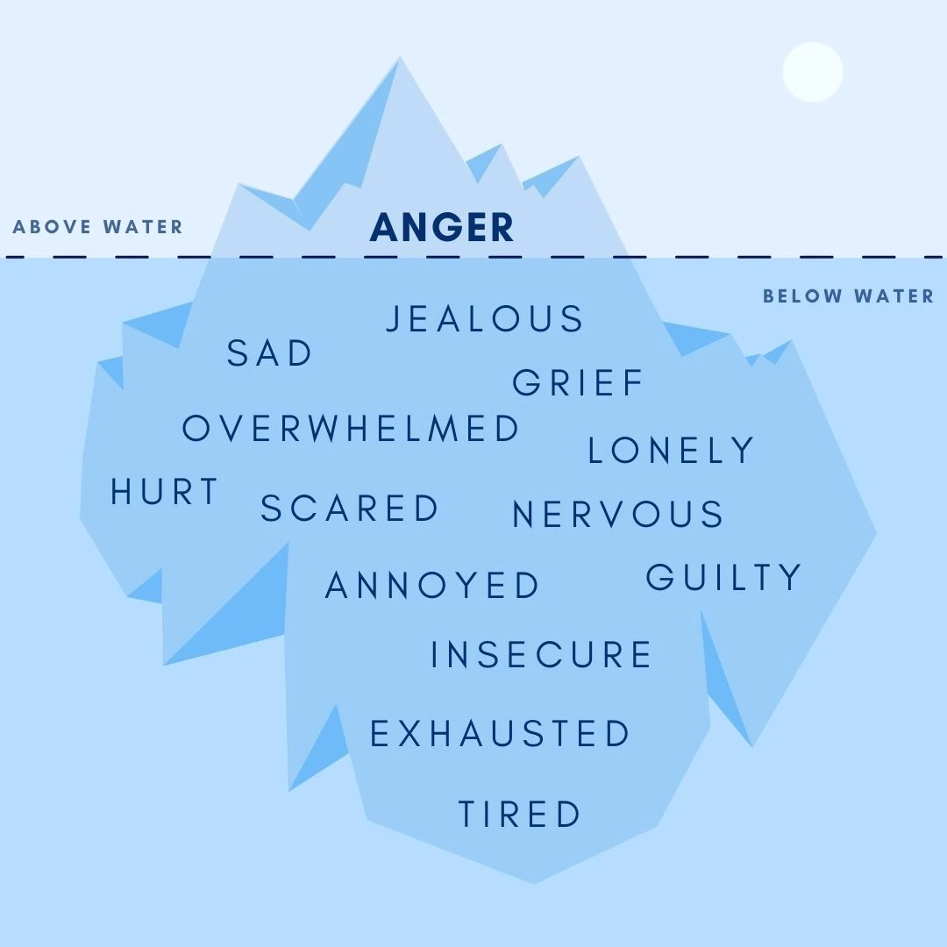
Anger Iceberg
"Tune into the emotion beneath"

Slide 16
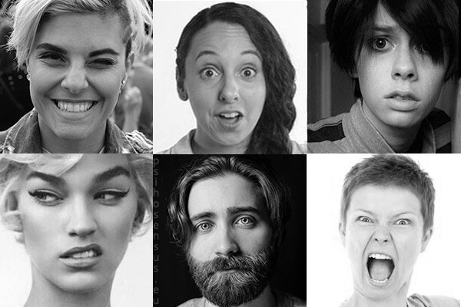
How can we categorise our core emotions as humans?
Fear
Anger
Joy
Disgust
Sadness
Surprise
"We all have emotions – they ensure our survival."
Dr. Paul Ekman (American Psychologist)
Notes:
Fear
Anger
Joy
Disgust
Sadness
Surprise

Slide 17
Why do Emotion Coaching?
Research has identified advantages in using Emotion Coaching in UK educational and community settings:
The findings demonstrate that Emotion Coaching in settings helps:
• children to regulate, improve and take ownership of their behaviour
• children to calm down and better understand emotions
• practitioners to be more sensitive to children’s needs
• create more consistent responses to children’s behaviour
• practitioners to feel more ‘in control’ during incidents
• fosters positive relationships between adults and children by promoting trust
• accelerate academic attainment
Rose et al.,( 2015); Gus et al., ( 2017)

Slide 18
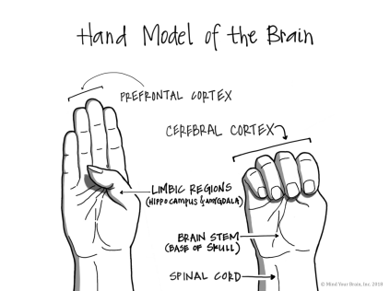
Flipping your lid – “We’ve all done it.”
Notes:
Think of a young person that you have taught where you may have seen them ‘Flip there lid’. Can you think of an example when you have flipped your own lid?

Slide 19
Attachment and Attunement
Attachment is made possible by attunement
Attunement refers to the ways in which internal emotional and bodily states are the focus of attention and ‘seen’ by the adult within the child-caregiver relationship (Siegel,2012)
Attunement promotes a sense of ‘felt security’ in the child and enables the development of ‘internal working models’ that inform behaviour.

Slide 20
The 4 Ss of Attachment (Siegel, 2012)
Secure, nurturing environments and stimulating, engaging experiences help to support the growth of neuronal networks to help build the brain and create a sense of being.
Seen
Safe
Soothed
Secure

Slide 21
Empathy v sympathy
https://youtu.be/KZBTYViDPlQ

Slide 22
Emotion Coaching - a style of communication
Dismissing
Avoids emotions/wants to get over emotion quickly
Uses distraction
Jumps straight to problem solving
"you'll get over it"
Laissez Faire
Shows lots of empathy but does not set limits
Have a ‘hands off’ idea about handling emotions
Shows own emotions but unable to resolve them
"anything goes"

Slide 23
Emotion Coaching - a style of communication
Disapproving:
Judges and criticises emotions
Viewed as sign of weakness
May see emotional display as manipulation
"toughen up"
Emotion coaching
Uses empathy to connect
All emotions are okay and healthy (but not all behaviours)
Remains calm and helps the child solve the problem
Are aware of his/her own emotions
"I understand, let me help you"

Slide 24
Emotional Response Styles
https://youtu.be/xs7OWBj_GiE

Slide 25
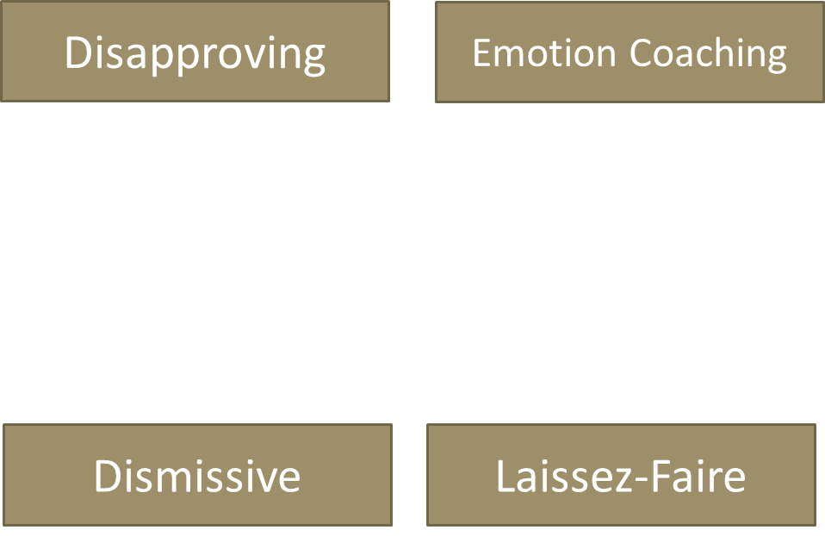
Emotional Response Styles

Slide 26
5 key stages on how to emotion coach...
1. Become Aware: Notice the child’s behaviour and tune in to the emotion beneath
2. Connect: Recognize emotional times as opportunities for intimacy and teaching
3. Accept: Listen empathetically and validate child’s feelings
4. Reflect: Help the child to verbally label child’s emotions
5. End Stage: Set limits on the child’s behaviour whilst helping the child to problem solve
Become Aware
Care

Slide 28
https://youtu.be/QT6FdhKriB8
1. Become Aware
2. Connect
3. Accept
4. Reflect
5. End Stage
Emotion Coaching at its best.

Slide 29
Being an emotion coach: Example
You are going to complete some examples. There might be a number of different feelings. Emotion Coaching responses could include asking questions about what happened, reflecting your child’s feelings and conveying acceptance and empathy.
Example: Your child says that they like a boy or girl at school, but then comes home and says that they hate this person.
What is your child feeling? | Anger
How could you emotion coach? | "Sounds like you are angry with him."
 | ?

Slide 30
Your child has not done their homework on time.
What is your child feeling?
How could you emotion coach?

Slide 31
Your child does not want to go to school .
What is your child feeling?
How could you emotion coach?

Slide 32
A conversation with your child:
“Things that make you feel good”.
Talk to your child and list the things that they do that makes them feel good or help them when they are feeling a bit down. Try not to suggest anything yourself, but be guided by them. If they don’t come up with anything right away, ask them to think about it for the next day and you can chat about it again.

Slide 33
Cautionary note about research:
Neuroscience is a relatively new field focusing on the brain, cognition and behaviour. Although research is credible and current, it is important to acknowledge it is tentative and indicative; there is still much about the brain and bodily functions to investigate.
For the majority of our pupils, we believe this approach will be successful if implemented correctly and consistently; however, with some pupils, it may take time or perhaps not always work and we will continue to support those pupils and in turn, staff, who regularly work with them.

Slide 34
In-school support:
Pastoral Structure (Form Tutor and Pastoral Leader)
Restore (bespoke sessions with Mrs Dodds and Mrs Richards)
Trinity – Drop in Den (Tara and Isaac)
Trinity Talks – by appointment
School Health referrals
Primary Mental Health referrals
CYPS referrals

Slide 35
Sources of online support
https://www.nhs.uk/every-mind-matters/mental-wellbeing-tips/youth-mental-health/

Slide 36
Sources of online support
https://www.mind.org.uk/
https://www.kooth.com/
https://www.youngminds.org.uk/

Slide 37
“Negative feelings dissipate when young people can talk about their emotions, label them and feel understood ...
… Children need to understand that their feelings are not the problem, their behaviour is.”​
(Gottman, 1997)

Slide 38
Key Take Aways:
Become Aware: Notice the child’s behaviour and tune in to the emotion beneath
Connect: Recognize emotional times as opportunities for intimacy and teaching
Accept: Listen empathetically and validate child’s feelings
Reflect: Help the child to verbally label child’s emotions
End Stage: Set limits on the child’s behaviour whilst helping the child to problem solve
The A B C Approach:
A: Empathise, validate and label
B: Set limits - clear boundaries whilst preserving dignity
C: Problem solving (calm, relaxed, rational state)
Become Aware
&
Care

Slide 39
Key Take Aways: Impacts of Emotion Coaching
Creating a culture of positive relationships throughout school between pupils and staff.
Increased buy-in from pupils in the classroom
Decreased suspensions and permanent exclusions
Increase in academic attainment
The offering of specialist provision for pupils with SEMH
Potential decrease in staff absence
Increase emotional wellbeing for pupils (and their families)
“Pupils’ level of satisfaction with their relationships with teachers is the most important contributory factor to their overall happiness at school” (Rees et al, 2013)

Slide 40
Parent/Carer feedback
We will shortly be sharing a link for an online questionnaire to gather stakeholder feedback on mental health provision at HMS.
We have developed a draft policy for social, emotional and mental health and value your views.

Slide 41
THANK YOU
Any questions?

Slide 42
Additional literature sources
https://digital.nhs.uk/data-and-information/publications/statistical/mental-health-of-children-and-young-people-in-england/2017/2017
https://www.bbc.co.uk/news/health-46306241

Slide 43
https://youtu.be/AjOL_dXPp9Q

