Slide 1
Whithaugh Park Information Evening
3rd May 2023

Slide 2
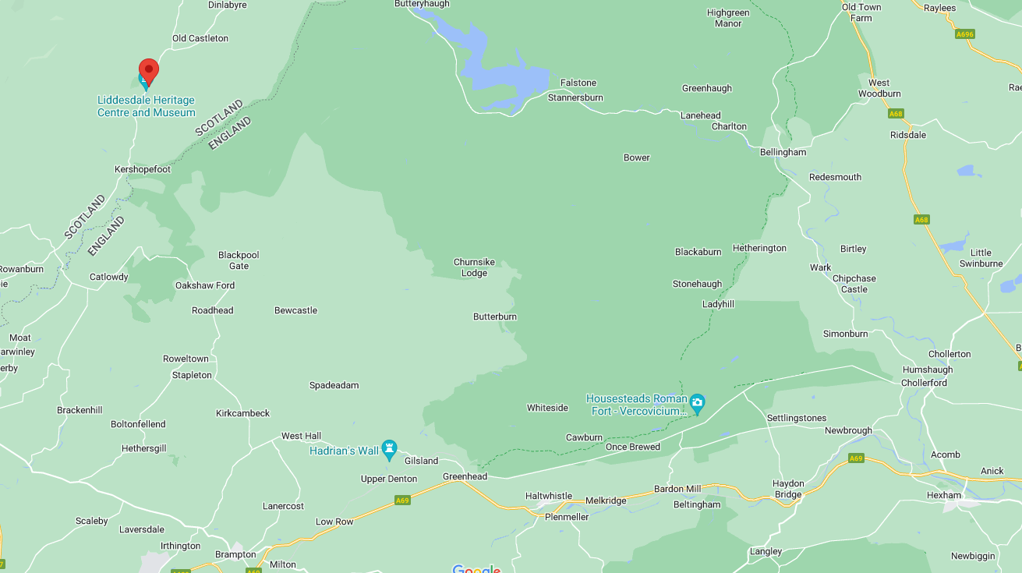
Whithaugh Park Information
Location: Newcastleton
Travel Time – (approx.) 1 Hour 20 mins.

Slide 3
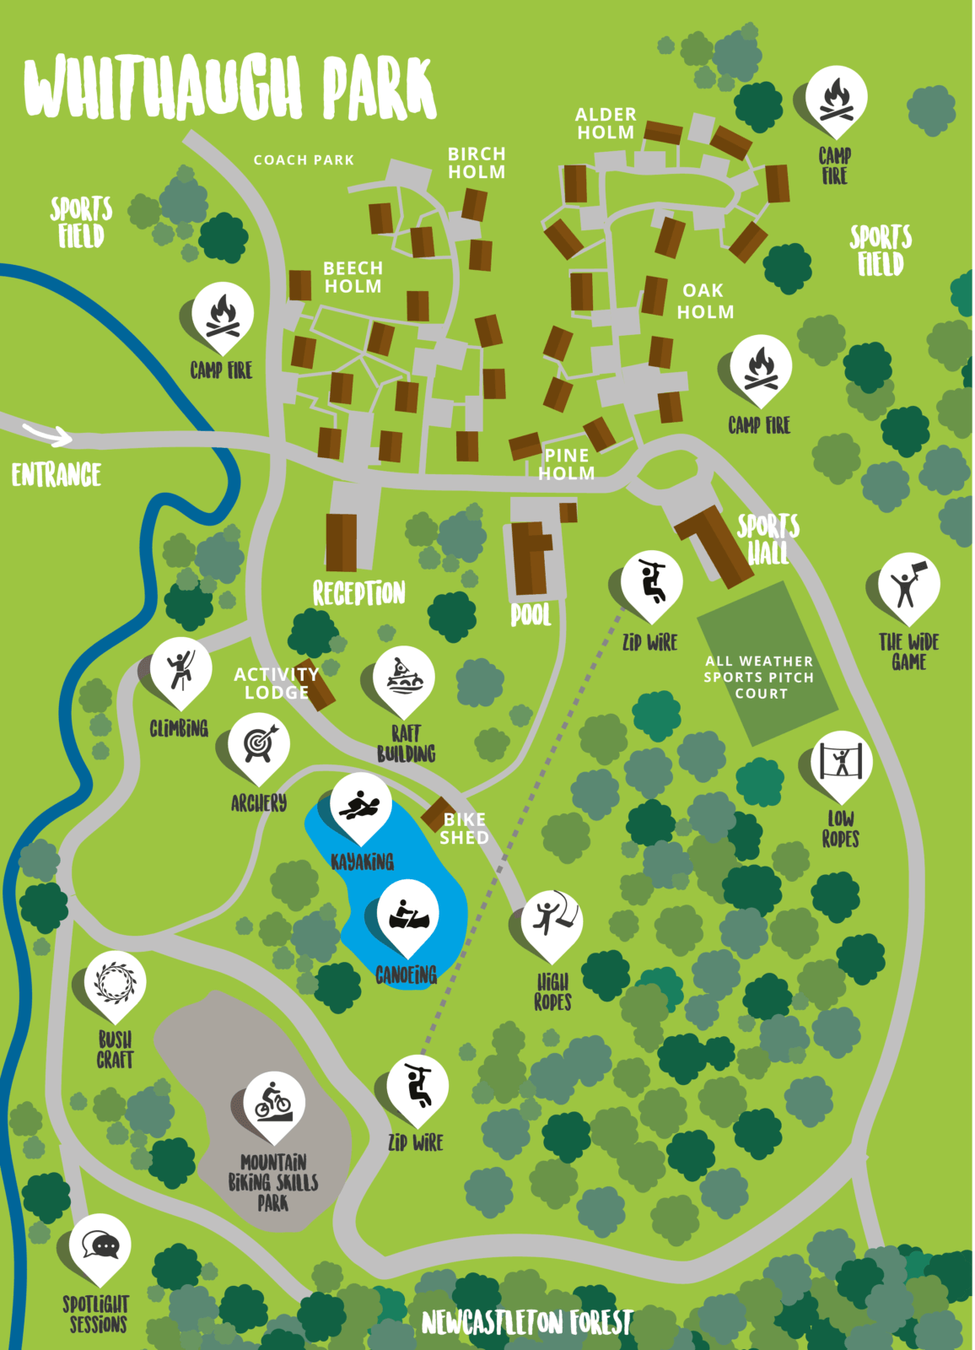
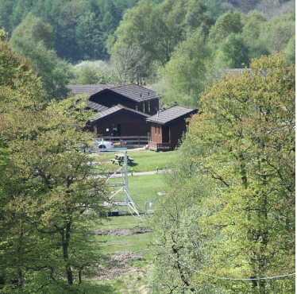
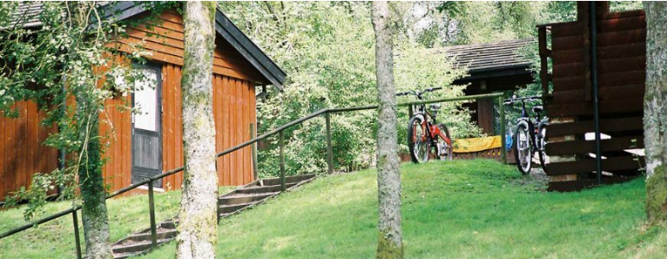
The site:
Cabin accommodation
All activities are on-site
Access to the all-weather sports pitch, zip wire, swimming pool and the rest of the facilities.
All meals provided
Dietary requirements should have been completed on the google form – if there is anything more, please get in touch

Slide 4
Our Trip
Y5 staffing:
Miss Liddle, Mr Nichol, Mr Barrass, Mrs Coldwell, Mrs Downes, Mr Drummond, Miss Scott, Mr Robson, Mr Johnson
Y6 staffing:
Miss Liddle, Mrs Hall, Mrs Hinchcliffe, Miss Bell, Mrs Alderson, Miss Kingett, Mr Robson
I will lead on both trips and hold the emergency school phone.
Pupils will not be allowed to bring their mobile phones with them.

Slide 5
Kit List/what to pack
Medical – Any inhalers, daily medicines/tablets
Kit – (all may become wet – please pack accordingly)
Old spare trainers and dry trainers (wellies)
Indoor shoes
Suitable nightwear
Swimming costume
Trousers/shorts for activities (not jeans for activities)
T-Shirts (enough for three days with some becoming wet)
Underwear
Warm hat, gloves, coat etc.
Warm jumpers
Waterproof jacket
Bag for muddy kit (I’ll be bringing bin bags!)
Drinks bottle
Torch
Towels for showering and activities (2)
Wash bag containing soap, shampoo, toothpaste, toothbrush.
Specific full change of clothes for after the raft building session – they will get wet!
PLEASE ENSURE THAT ALL ITEMS ARE CLEARLY MARKED AND LABELLED WITH YOUR CHILD’S NAME!

Slide 6
Itinerary - Logistics
Y5 – Wednesday 7th – Friday 9th June Y6 – Wednesday 21st – Friday 23rd June
Day One
8.40 – Arrival at school and registration in form groups. Organisation to take place in Fellside Hall.
Before 10.00am – Students leave school site.
11.30/12.00 – Arrival at Whithaugh Park, Newcastleton. Lunch upon arrival. Pupils assigned lodges and groups.
13.45 – Activity 1
15.45 – Activity 2
18.00 – Dinner – 2 course meal with vegetarian options.
19.30 – Activity 3
21.15 – Supper – hot chocolate and other snacks
21.30 – Bed and Sleep!

Slide 7
Itinerary - Logistics
Day Two
8.00 – Breakfast – self service – fruit juice, cereal selection, toast, jams, yoghurt, fruit etc.
9.00 Activity 4
11.00 Activity 5
12.45 – Lunch – Packed lunch – sandwiches, cup-a-soups, fruit, crisps, drinks etc.
13.45 Activity 6
18.00 Dinner
19.30 Activity 7
21.15 – Supper
21.30 – Bed and Sleep!

Slide 8
Itinerary - Logistics
Day Three
8.00 – Breakfast
9.00 – Depart from lodges
10.00 – 12.00 Use of facilities – all weather pitch/recreational lodge
12.00 – Packed lunch
12.45 – Leave to return to school
14.00 – Return to school and collection.

Slide 9
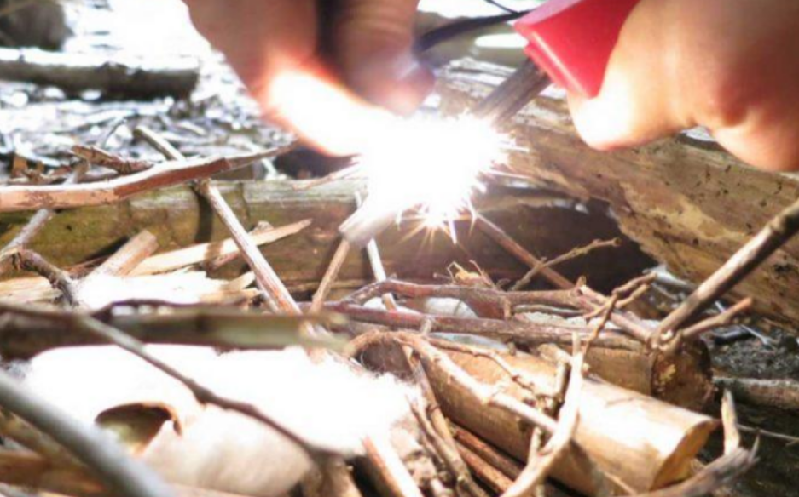
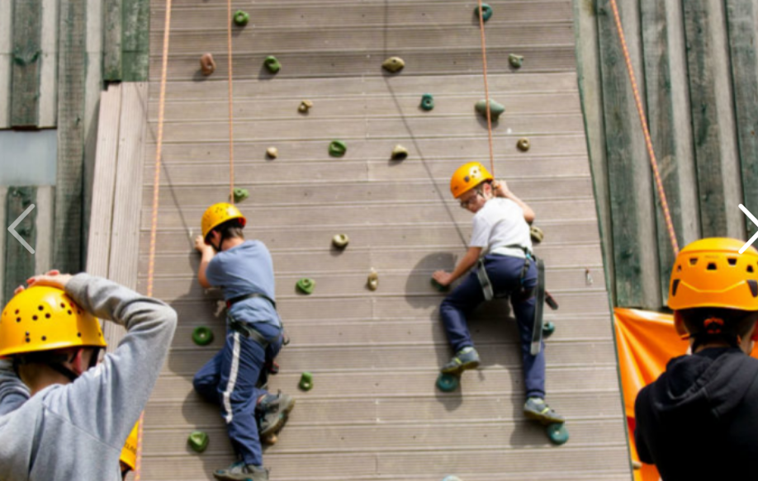
Activities
Having been split into groups, students will complete 7 of the following activities across the three days:-
Bushcraft
Climbing
Night Hike
Open Canoe
Raft Building
Self-led team building
Swimming (indoor pool)
Zip Wire

Slide 10
Accommodation and Groupings
Whilst staff will endeavor to ensure students are with social groups etc, it may not be possible to ensure that every student is with all of their social group at all times.
Miss Liddle and the team will assign accommodation and groupings as fairly and as sensibly as we can.
The primary concern is that all students have a fun, productive and restful time away and we will assign groups accordingly.
Please email Miss Liddle directly with any concerns regarding this.

Slide 11
Final information
For many children this is the first significant time they’ve spent away from home, but by the end of their school residential adventure trip their confidence will have grown massively.
Whithaugh’s instructors are really good at working with young children and helping them overcome fears and challenges to bring out a completely different side, which teachers may not have seen before.

Slide 12
To do –
Contact Miss Liddle (bliddle@hexhammiddle.org.uk ) with any queries. I will endeavor to answer them ASAP.
I am aware that some students may find it difficult being away from home – we will endeavour to do all that we can to ensure every single child enjoys their trip and remains with us. Should there be any issue, which we cannot solve and require parents/carers to pick up their child then we will contact you and ensure safety and supervision until your arrival.
Medical Emergency –
Doctors Bowley and Kennedy (local doctors near Newcastleton)
Casualty Department Cumberland Infirmary Carlisle (25 miles)

